Slide 1
MLB All Star Pitchers
Brian Goodman
Timothy Kelley
Daniel Russell
2015-2019

Slide 2
Scope
Our project is to uncover data trends among all star MLB pitchers from 2015-2019. We will examine relationships between their strikeout %, ERA (earned run average), BB (walk)%, in their all star seasons, as well as some of their physical dimensions and place of birth (state if domestic, country if foreign born).

Slide 3
Data Collection
Player Stats - CSV from https://stathead.com/
All Star Rosters - CSV from https://www.baseball-reference.com/
Player Physical Dimensions - API from http://lookup-service-prod.mlb.com/

Slide 4
Data Cleanup

Slide 5
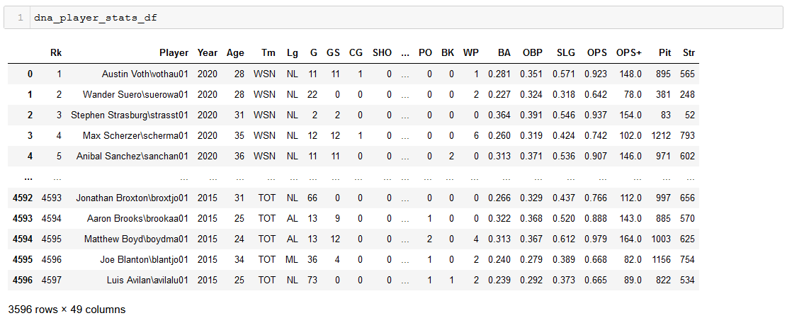
All Player Stats
Notes:
Player Stats read into DataFrame. All players for all positions from 2015-2020. 49 columns - basically 45 data points for each player for each year.

Slide 6
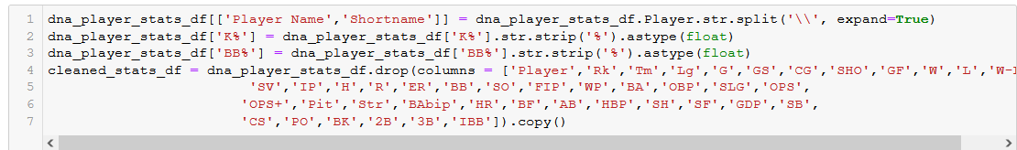
Placed player name and ‘shortname’ in separate columns
Convert KK% and BB% to their decimal representation
Remove unneeded columns

Slide 7
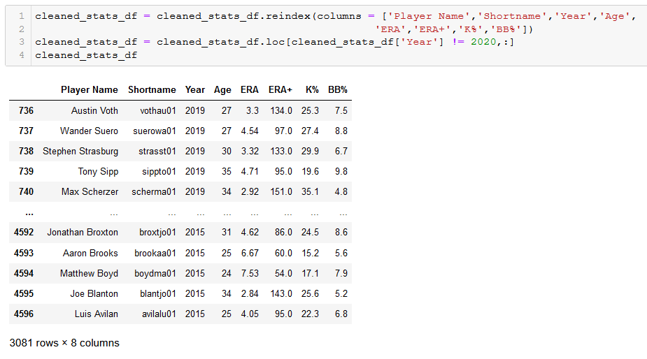
Rearranged columns
Removed 2020 (incomplete season)

Slide 8
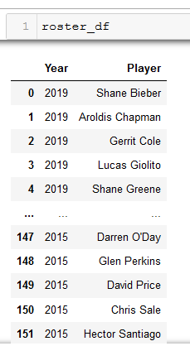

Slide 9
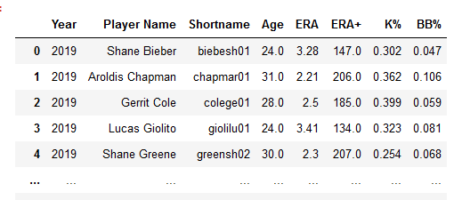
Merge
Generated a dataframe of stats for all star pitchers for each year they pitched as an all star which we then exported to reference while generating charts.

Slide 10
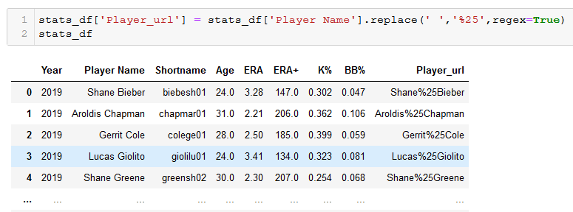
API Call

Slide 11
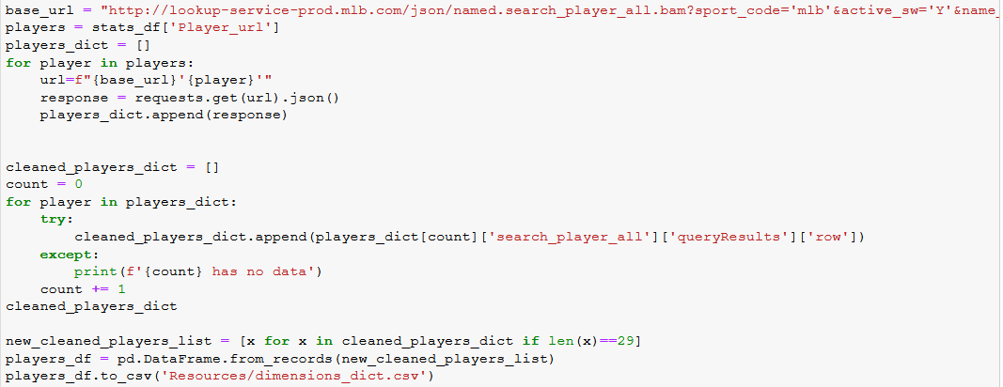
Notes:
Weird data pull. Some of the calls came back with a significantly smaller dataset (len == 2 instead of 29). Brian suggested that might be because some all star pitchers retired.

Slide 12
Exploring
Are there traits of pitchers to predict All-Star status?
We looked for relationships between birth place and physical dimensions of the athletes.
Notes:
Note that there was no all star game in 2020 due to a covid shortened season

Slide 13
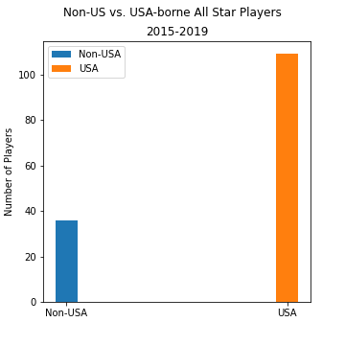
Where to find All Star Pitchers?
All Star pitchers were represented from all over the world.
But let’s break it down

Slide 14
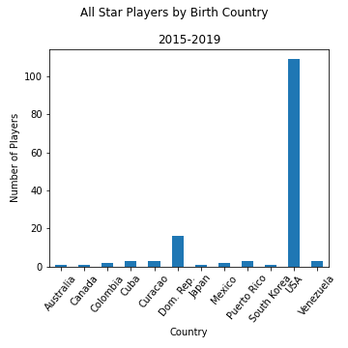
All Stars by Country
This is more detailed, but harder to visualize, lets keep going
Notes:
Many different flags, but if theyre all stars, they all fly the W in their home city

Slide 15
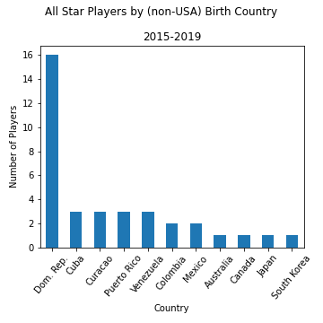
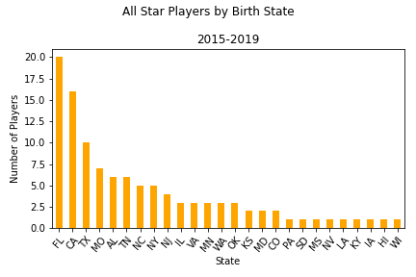
All Stars by States/Country

Slide 16
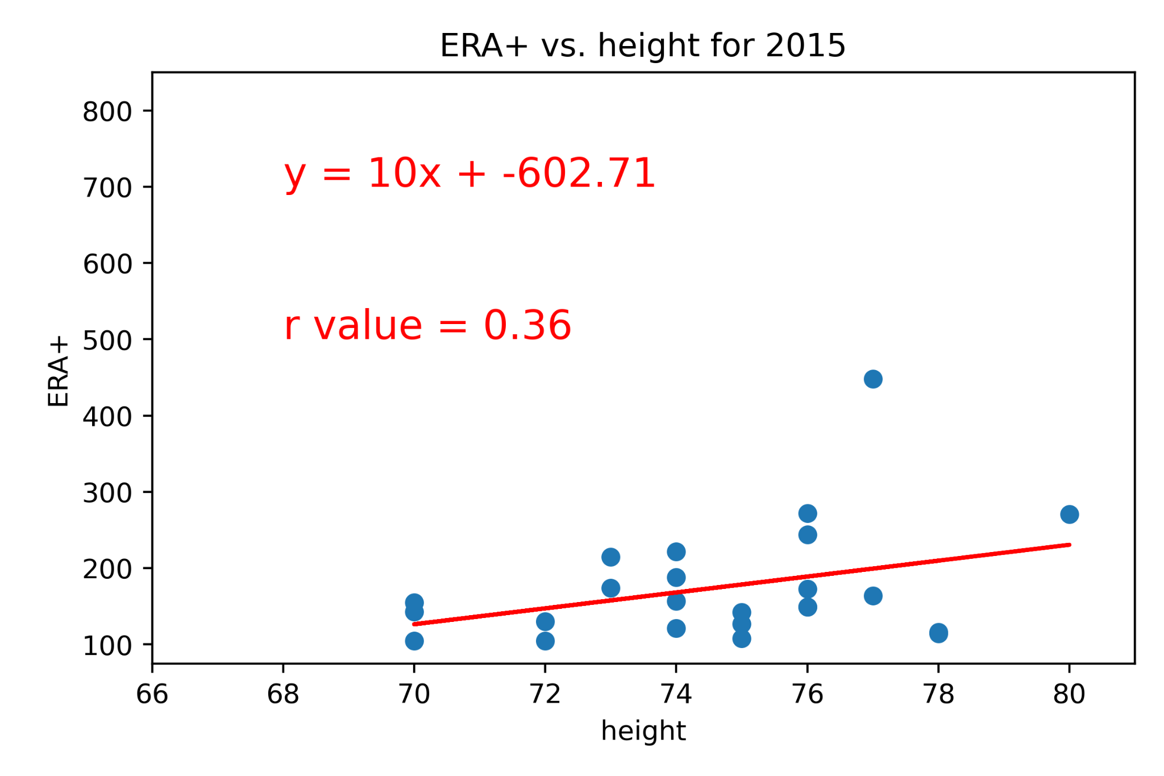
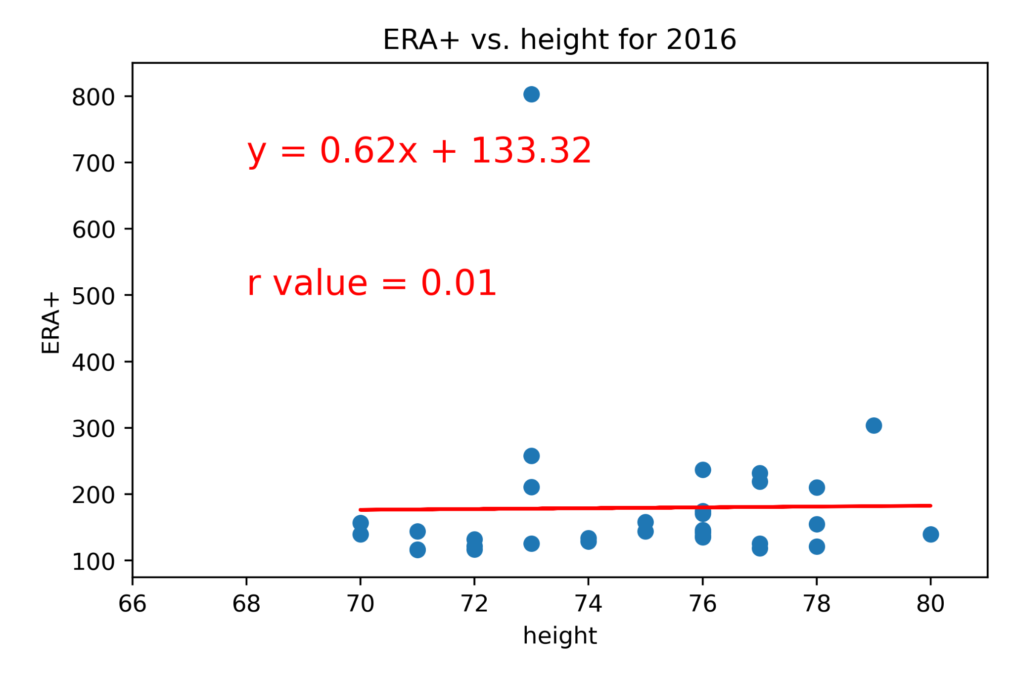
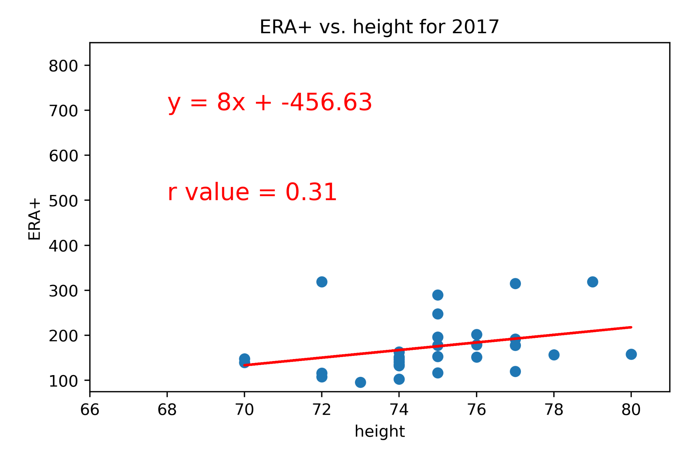
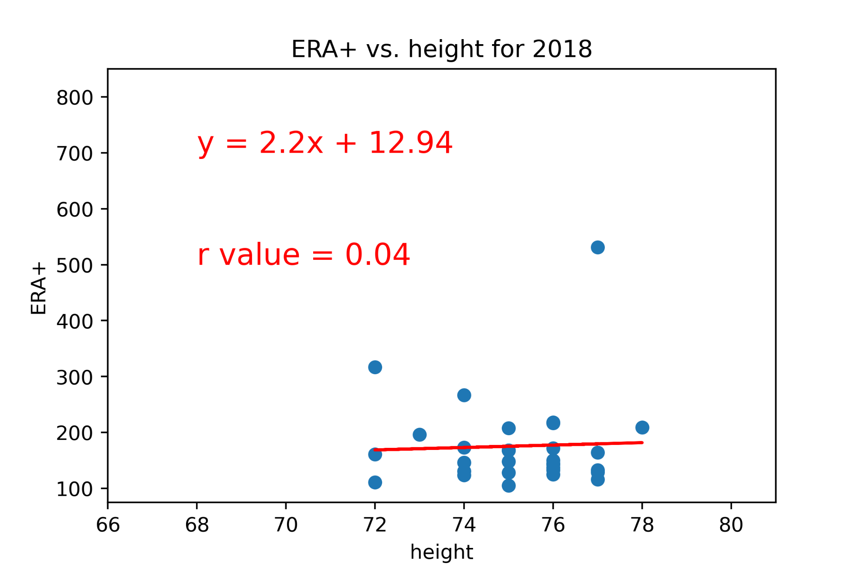
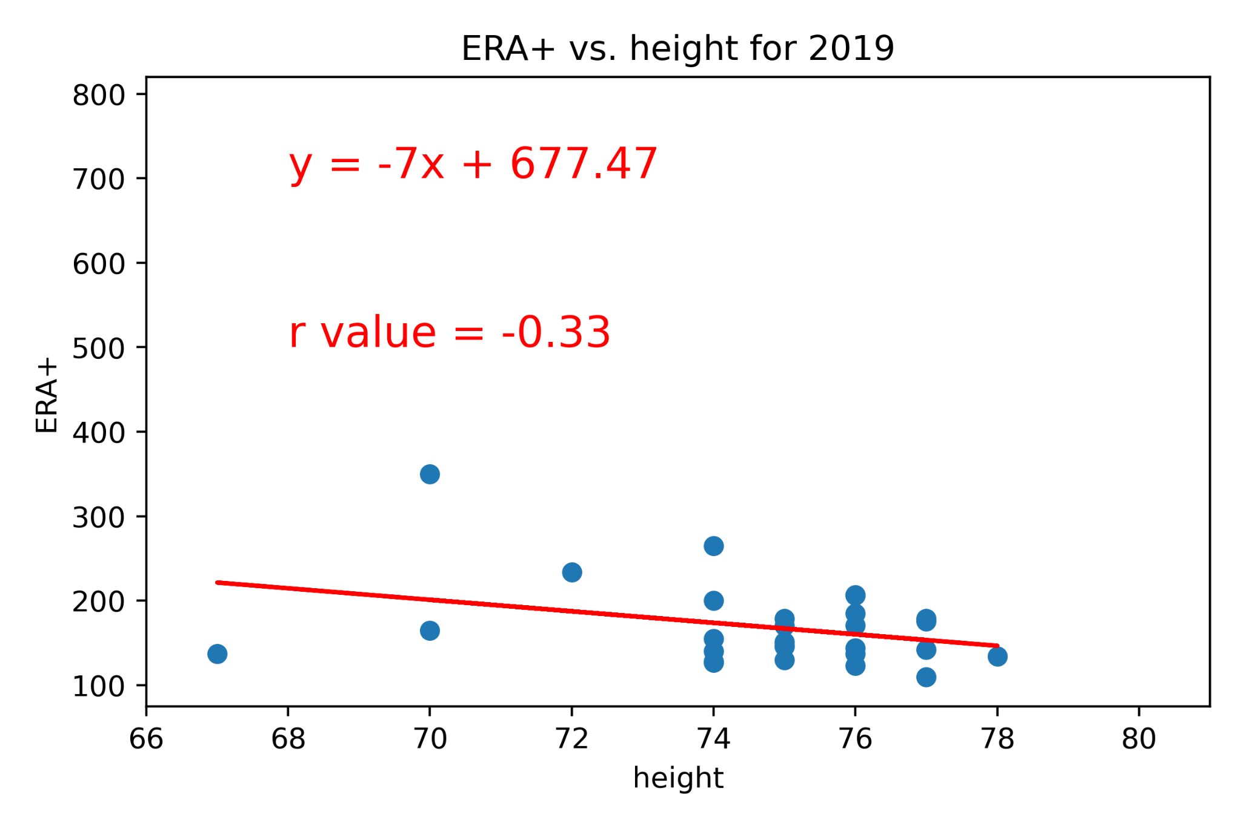
Does Height Predict ERA+?
Notes:
ERA+ is an indicator of the runs a pitcher allows (the higher the score, the better the pitcher)
Conclusion: Height is not a good predictor of ERA+
But...wait!!

Slide 17
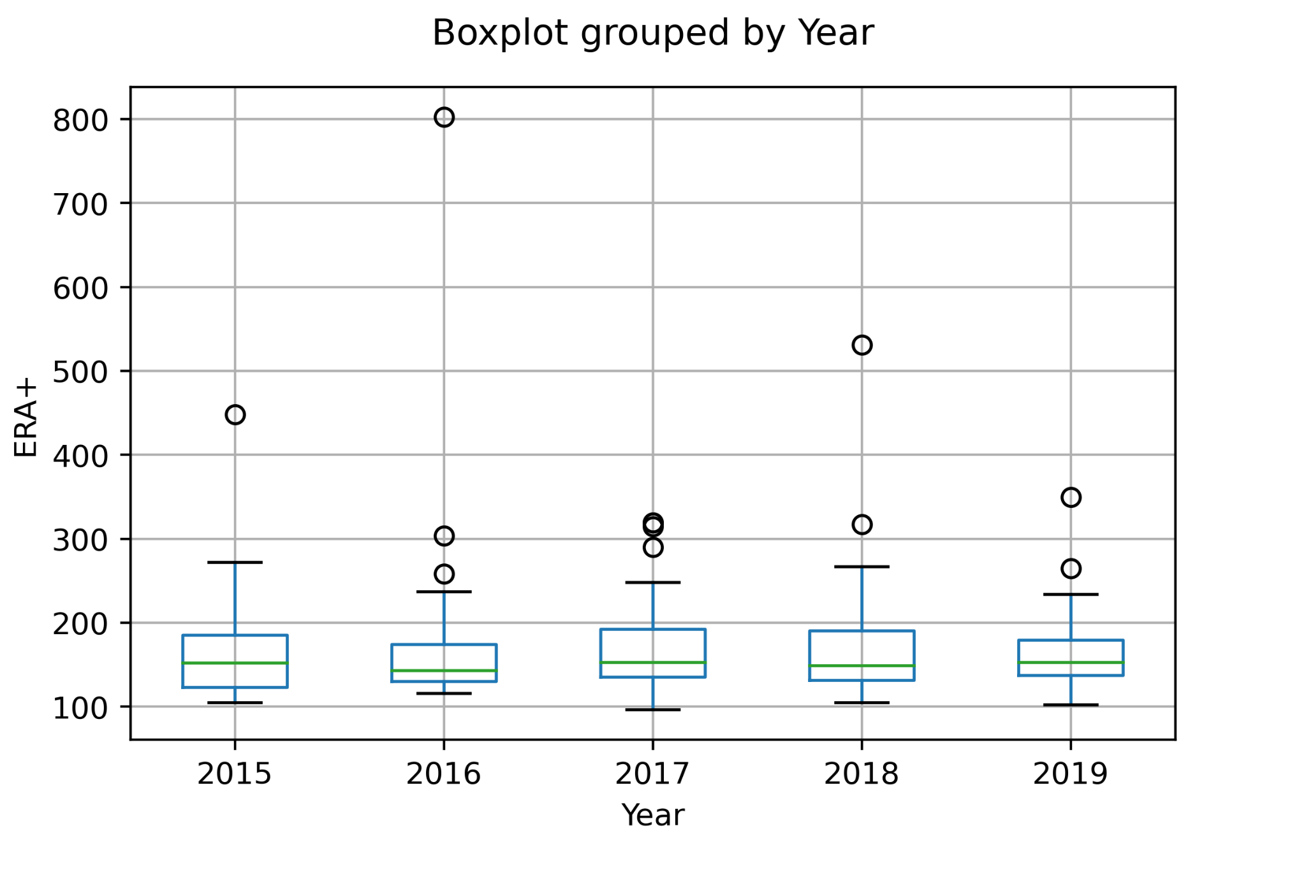
Angels in the Outliers
Could outliers skew the data?

Slide 18

Does Height Predict ERA+?
Notes:
ERA+ is an indicator of the runs a pitcher allows (the higher the score, the better the pitcher)
Conclusion: Height is not a good predictor of ERA+
But...wait!!

Slide 19
Does Height Predict ERA+?
Notes:
ERA+ is an indicator of the runs a pitcher allows (the higher the score, the better the pitcher)
Conclusion: Height is not a good predictor of ERA+
But...wait!!

Slide 20
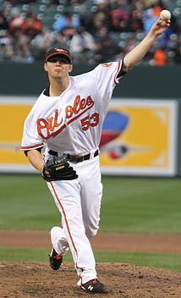
A moment for trivia!
From 2015 to 2017 this pitcher set an American League record by converting 60 straight saves
His 2016 ERA+ of over 800 was with the Baltimore Orioles, but he finished his career with the NY Yankees.
Zack
Britton
Notes:
ERA+ is an indicator of the runs a pitcher allows (the higher the score, the better the pitcher)
Conclusion: Height is not a good predictor of ERA+
But...wait!!

Slide 21
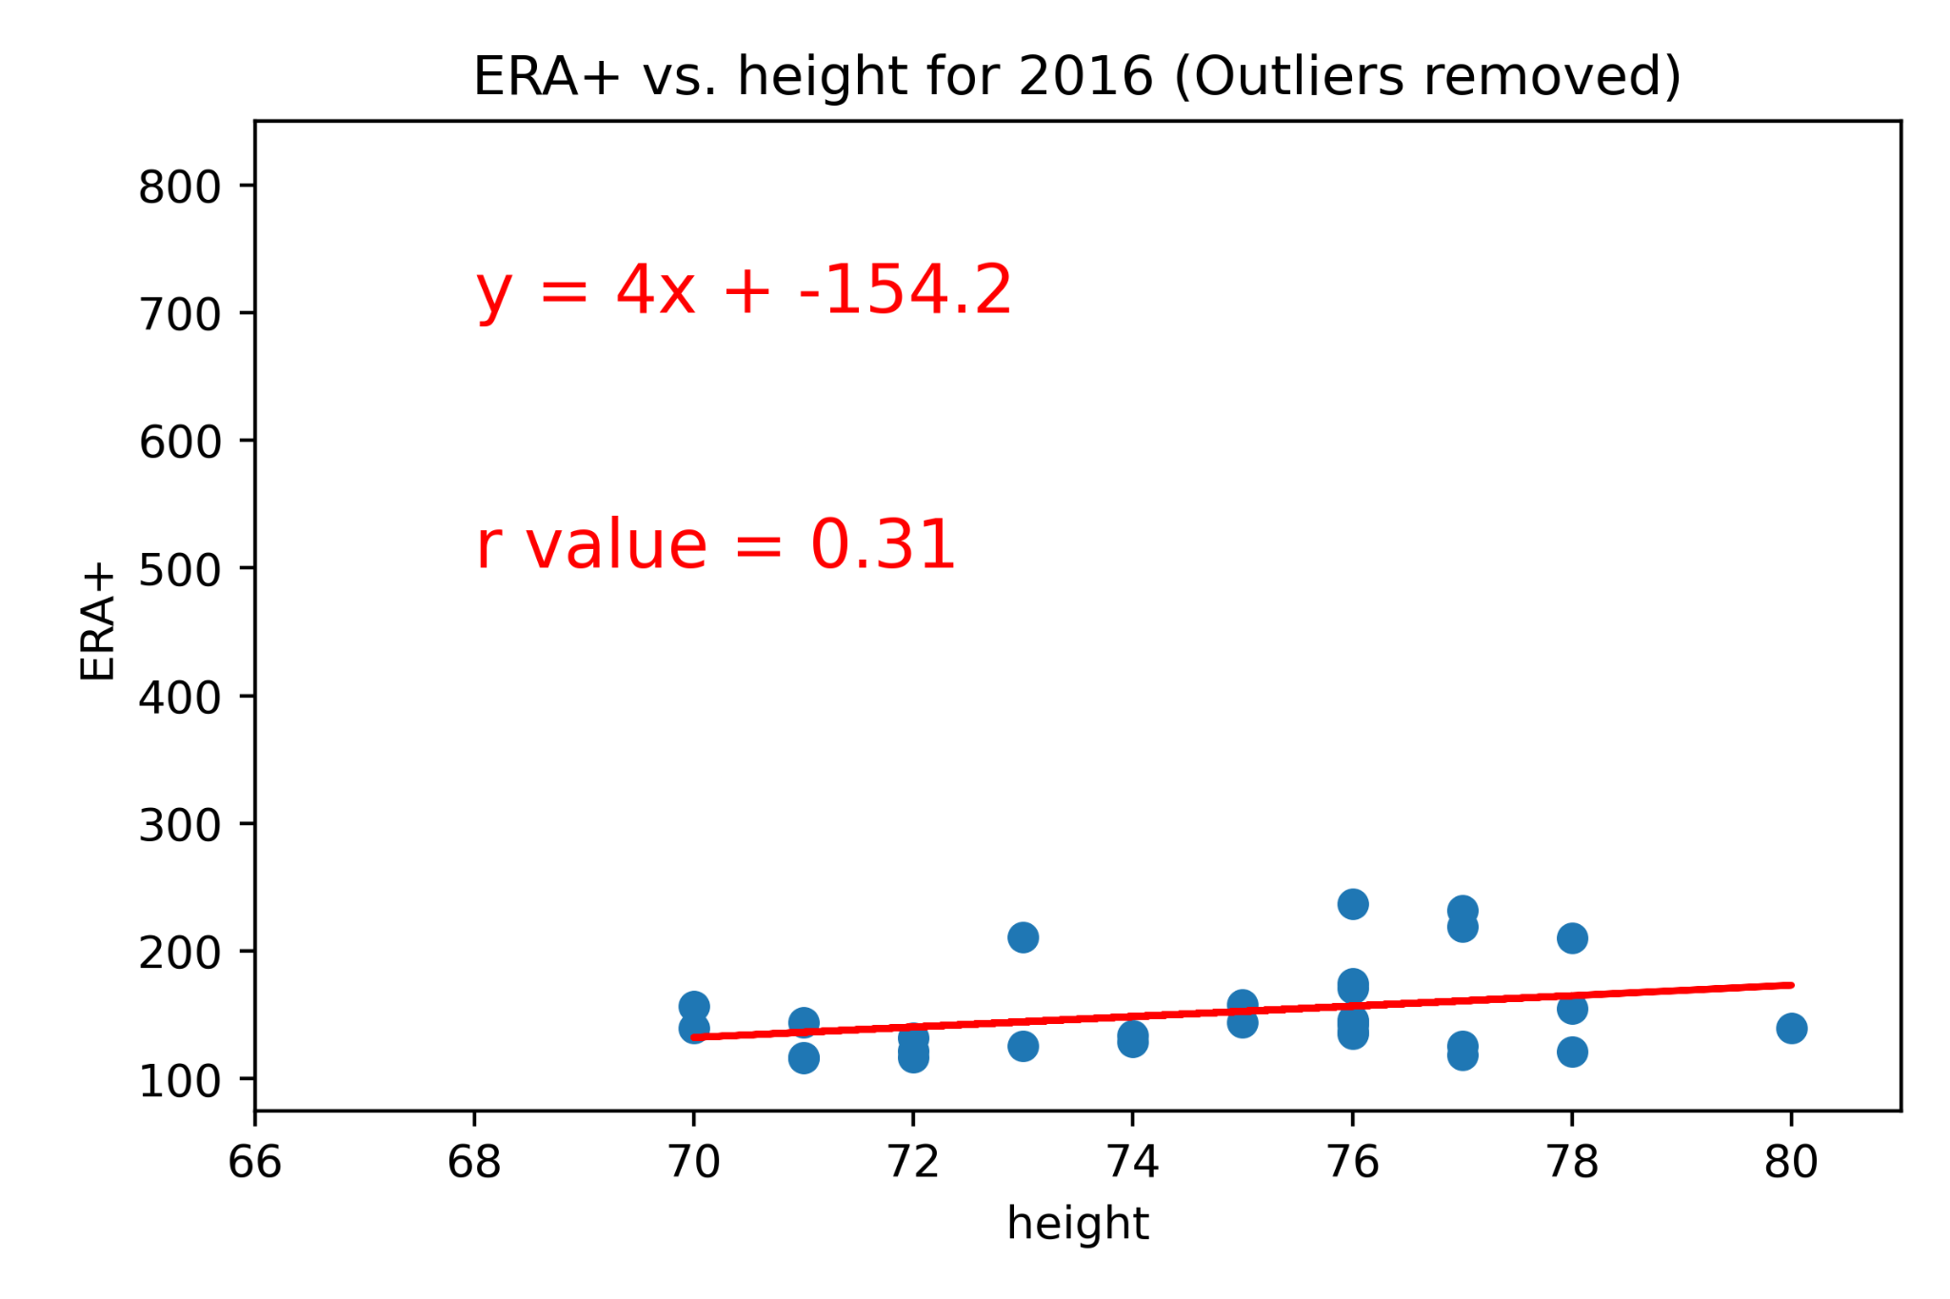
Does Height Predict ERA+?
Notes:
ERA+ is an indicator of the runs a pitcher allows (the higher the score, the better the pitcher)
Conclusion: Height is not a good predictor of ERA+
But...wait!!

Slide 22
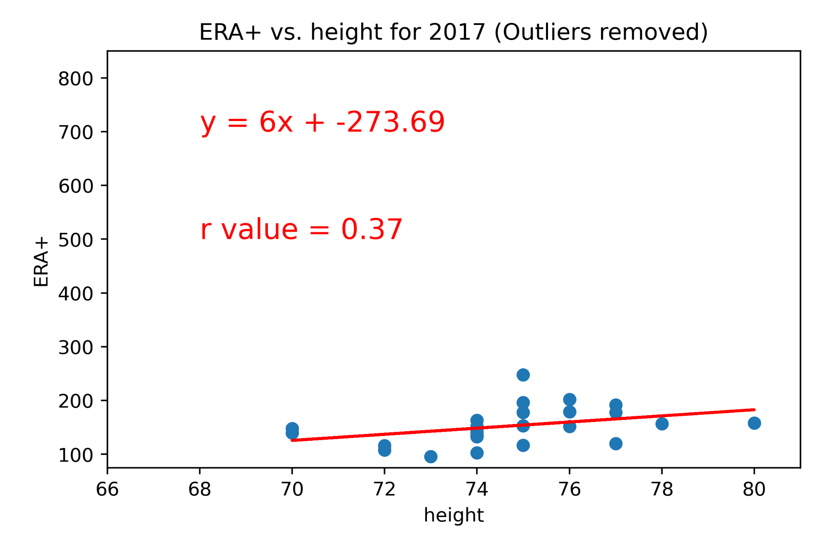
Does Height Predict ERA+?
Notes:
ERA+ is an indicator of the runs a pitcher allows (the higher the score, the better the pitcher)
Conclusion: Height is not a good predictor of ERA+
But...wait!!

Slide 23
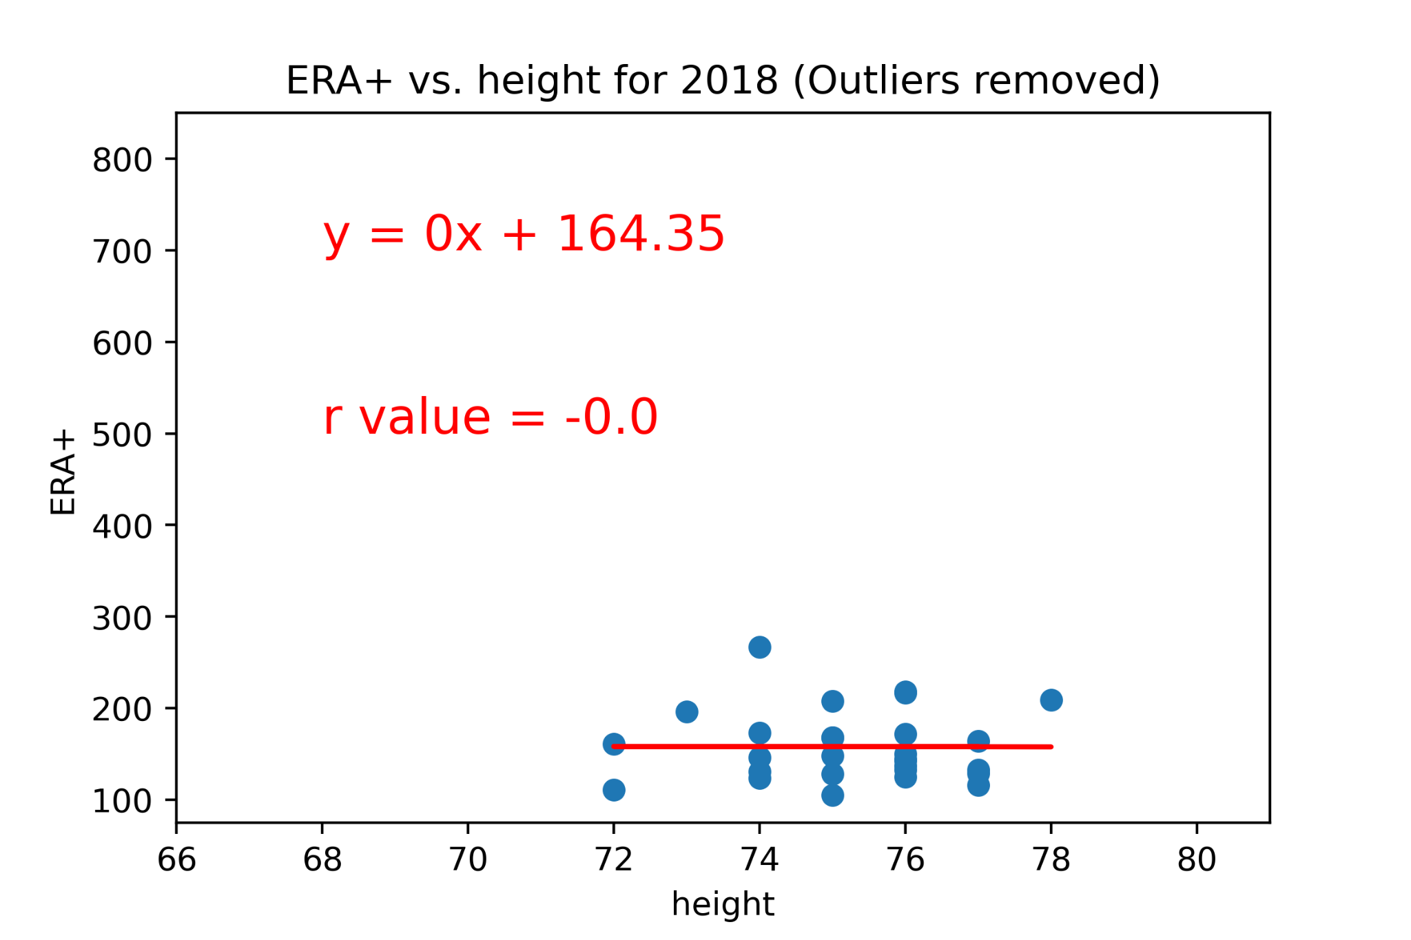
Does Height Predict ERA+?
Notes:
ERA+ is an indicator of the runs a pitcher allows (the higher the score, the better the pitcher)
Conclusion: Height is not a good predictor of ERA+
But...wait!!

Slide 24
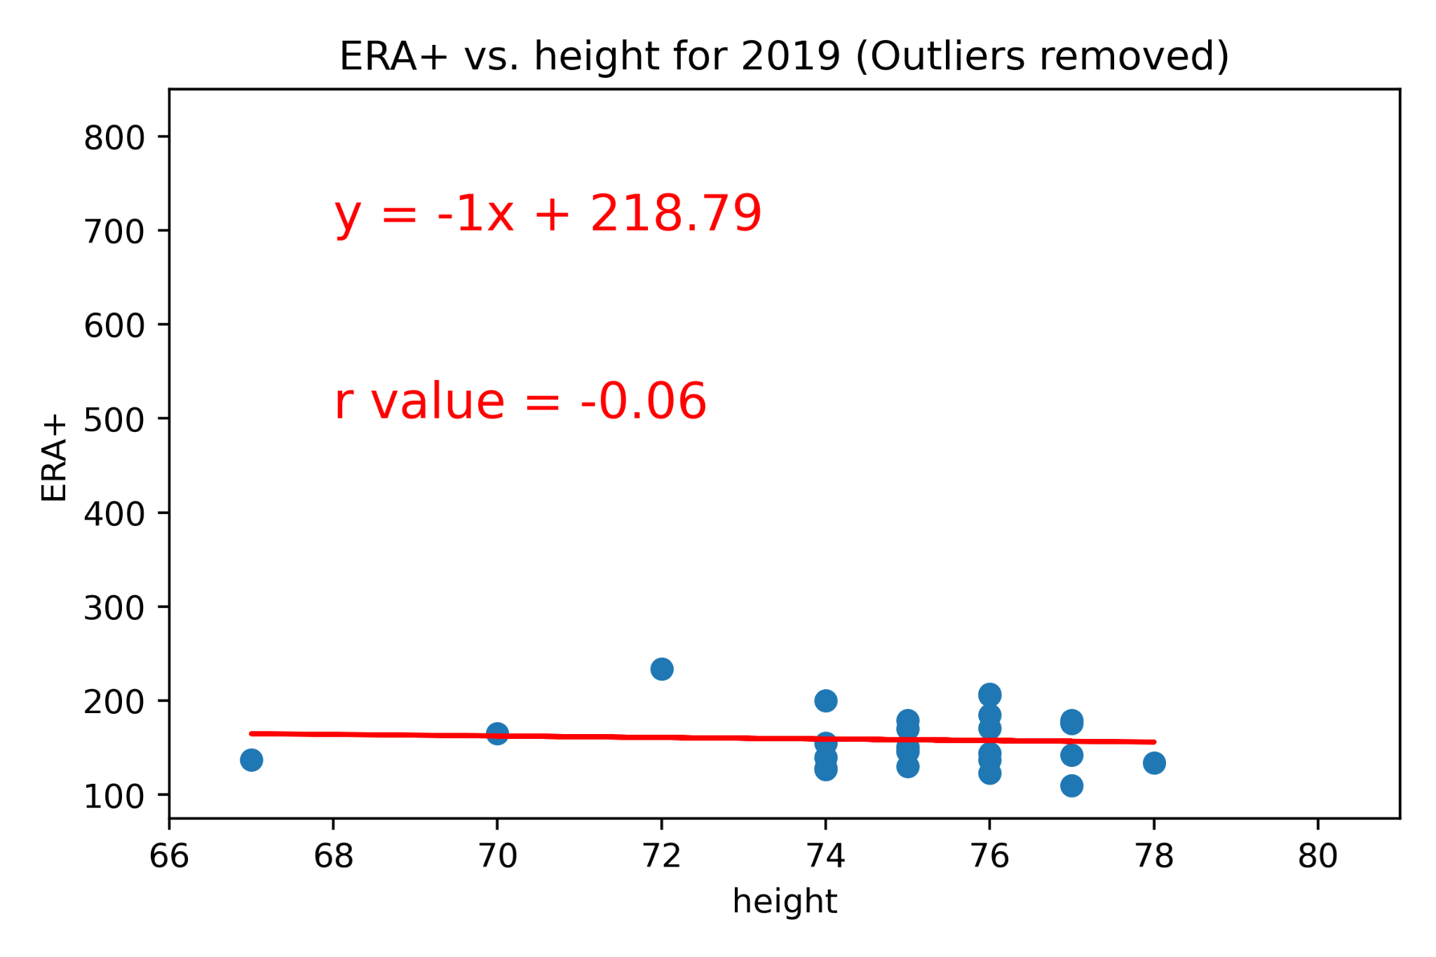
Does Height Predict ERA+?
Notes:
ERA+ is an indicator of the runs a pitcher allows (the higher the score, the better the pitcher)
Conclusion: Height is not a good predictor of ERA+
But...wait!!

Slide 25
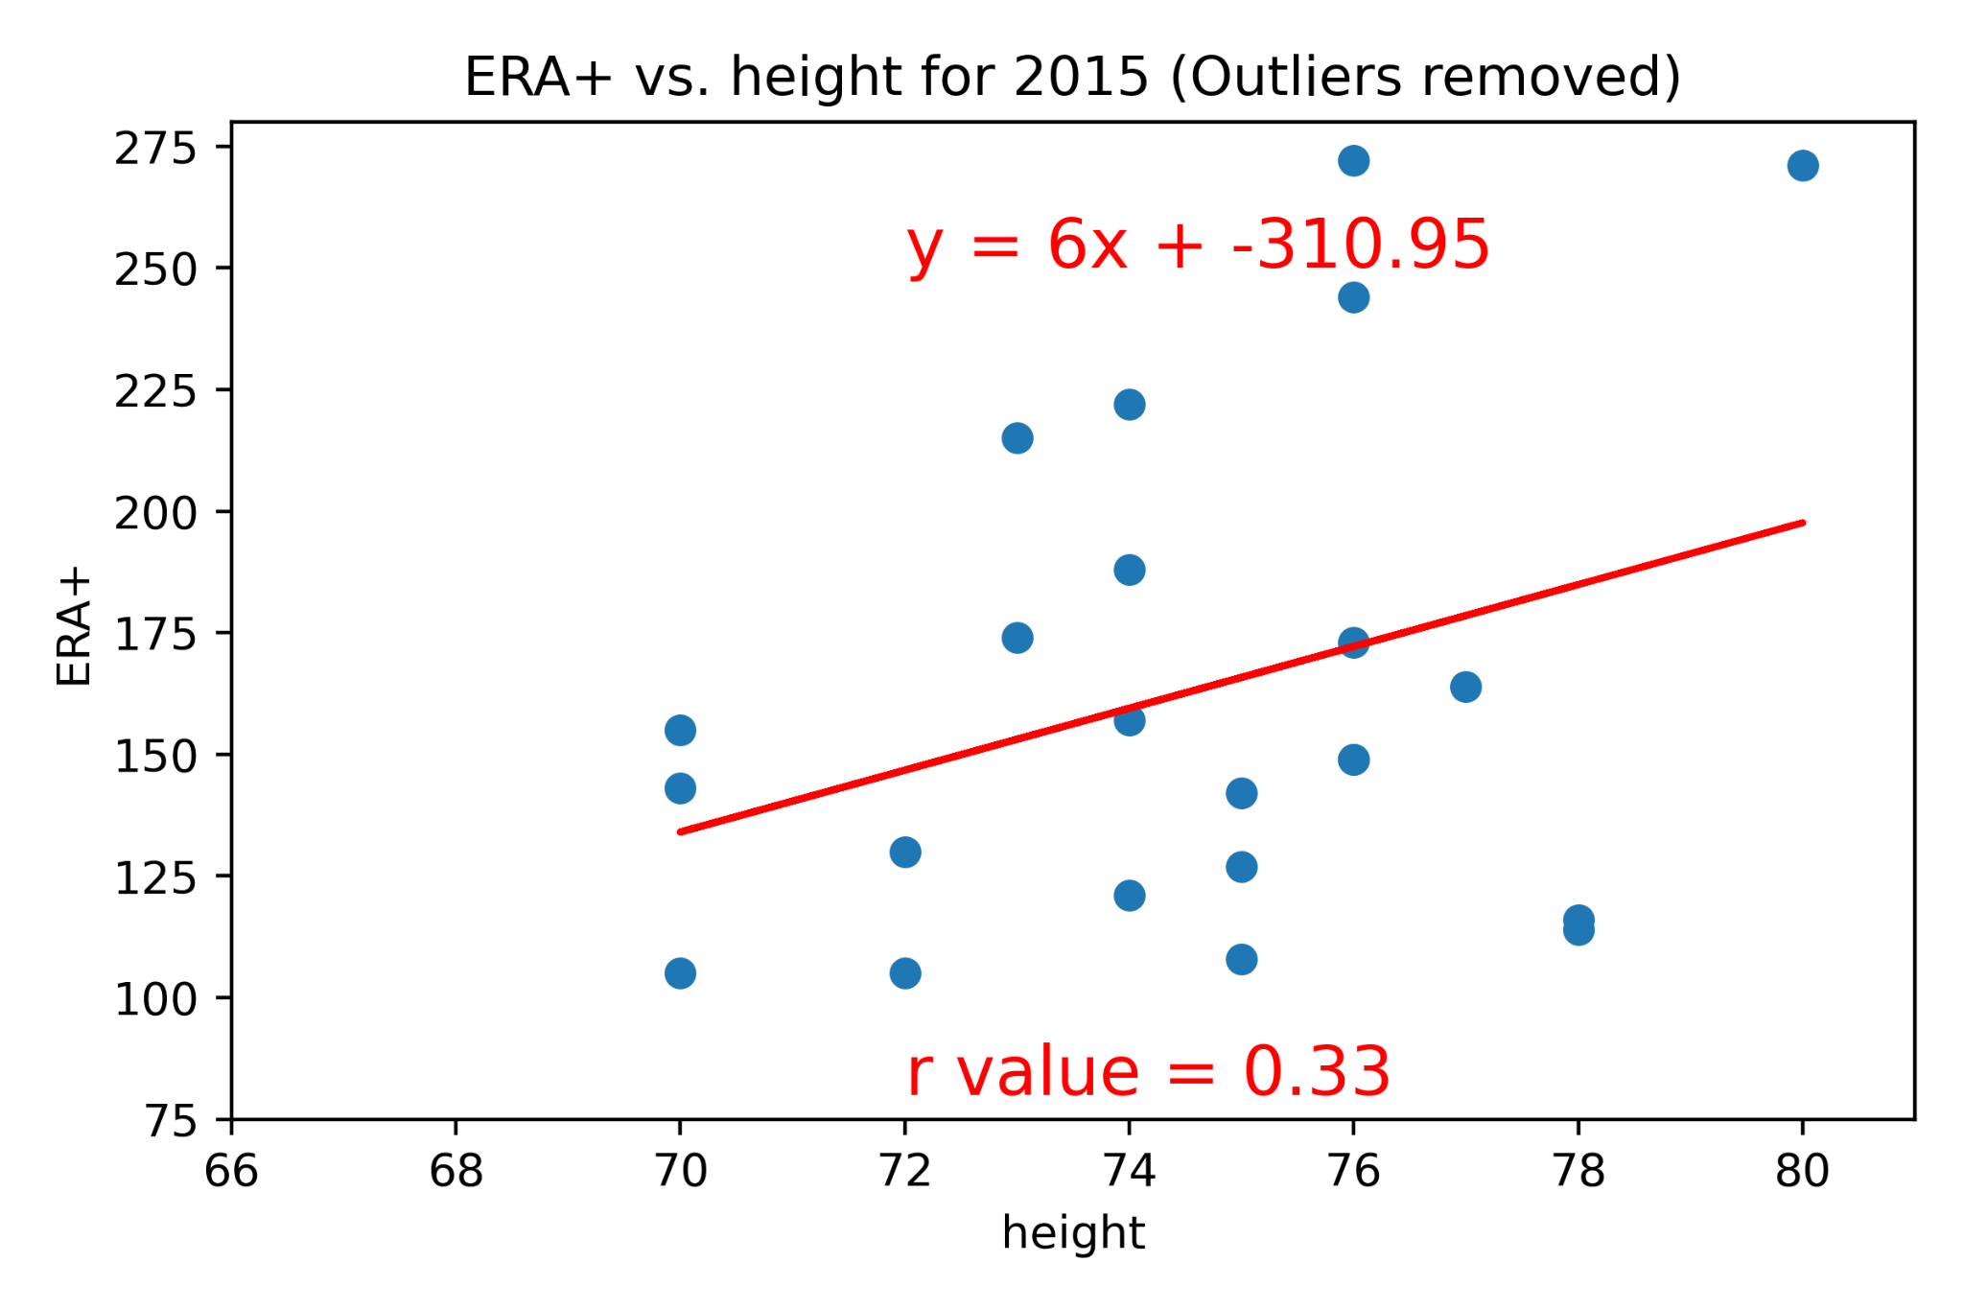
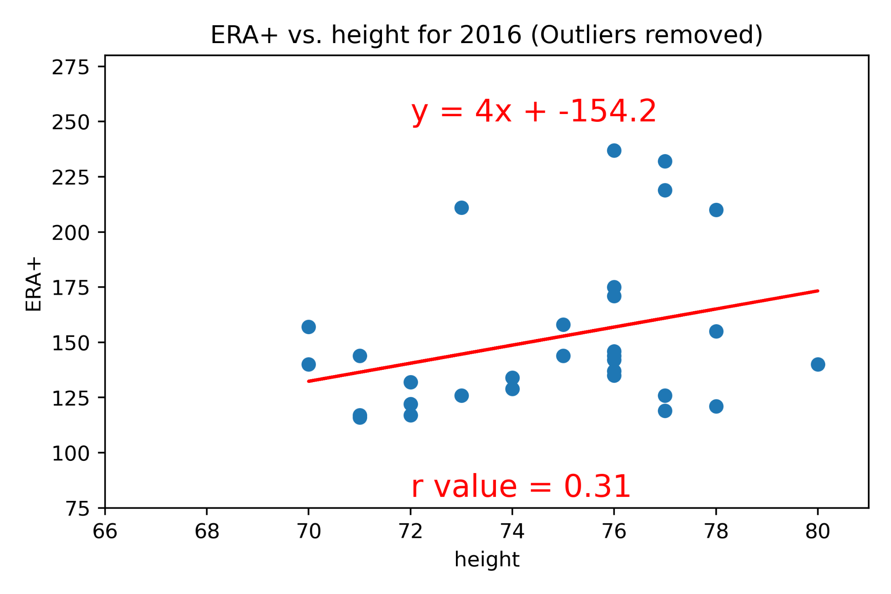
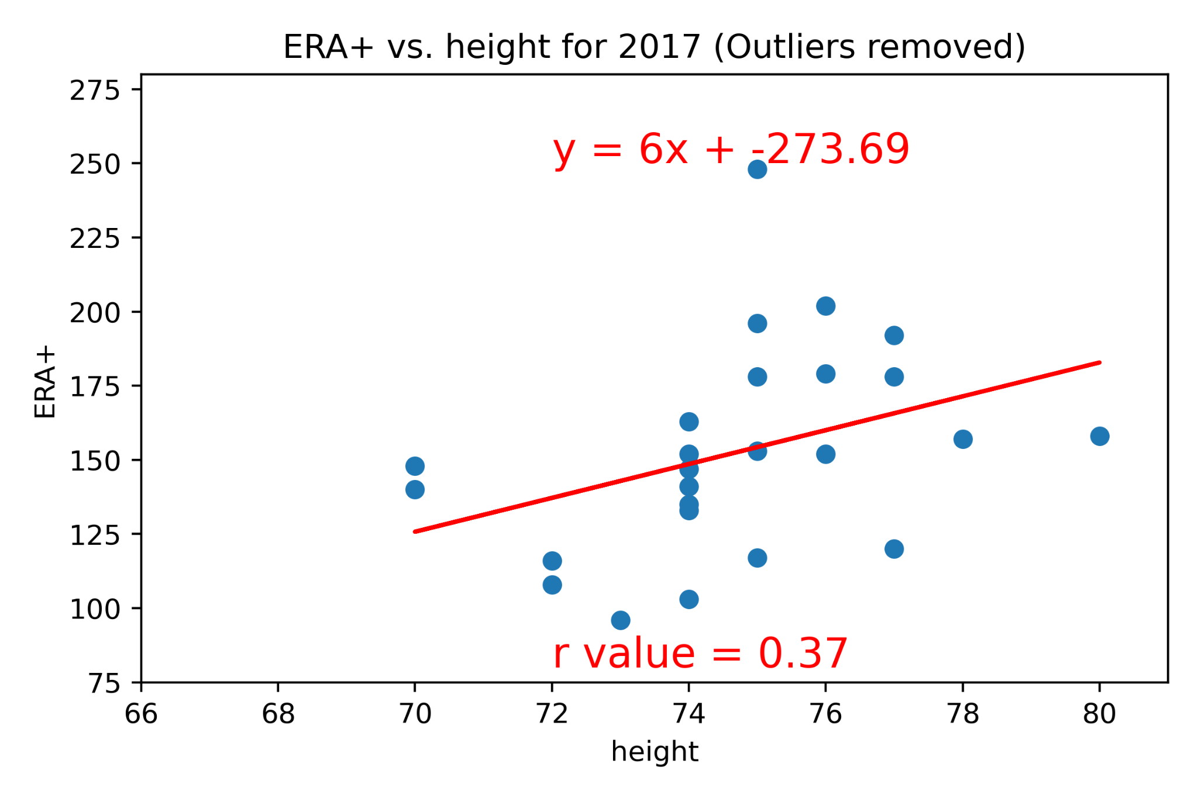
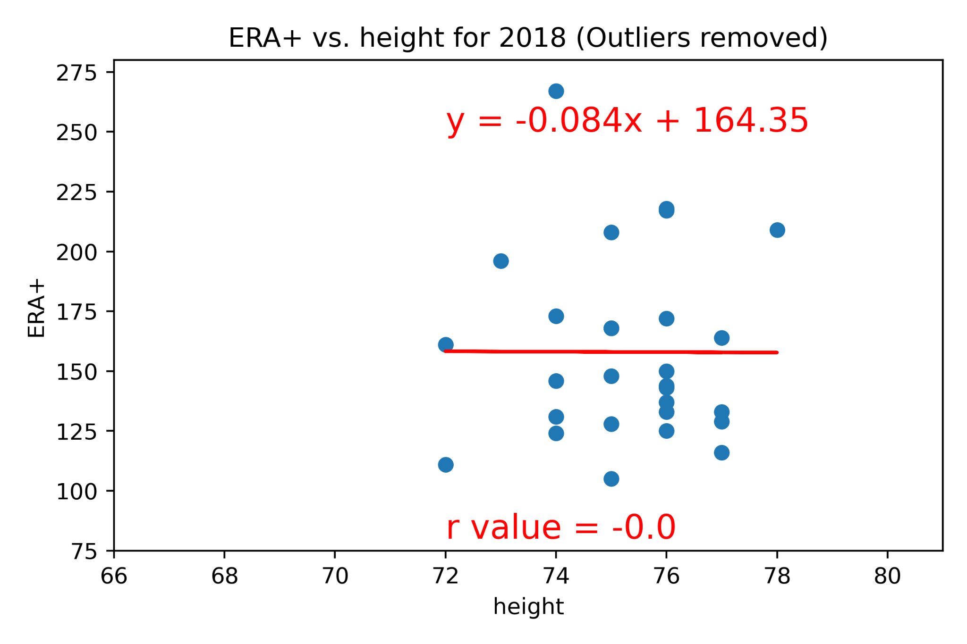
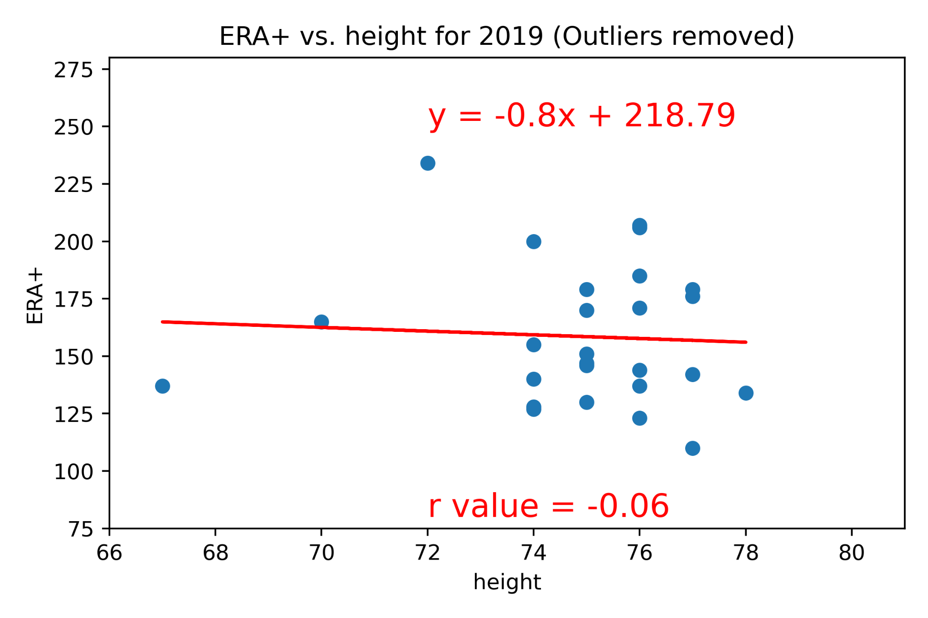
ERA+ Without Outliers
Notes:
Conclusion: Pitcher ERA+ was positively correlated for years 2015-2017, but appears to show no correlation in 2018/2019

Slide 26
ERA+ Without Outliers
 | Correlation with outliers | Correlation without outliers
2015 | 0.36 | 0.33
2016 | 0.01 | 0.31
2017 | 0.31 | 0.37
2018 | 0.04 | 0.00
2019 | -0.33 | -0.06
Conclusion: Pitcher ERA+ was more positively correlated for years 2015-2017, but appears to show no correlation in 2018 & 2019

Slide 27
Insights
Data trends among All Star Pitchers in Major League Baseball from 2015-2019
Notes:
Note that there was no all star game in 2020 due to a covid shortened season

Slide 28
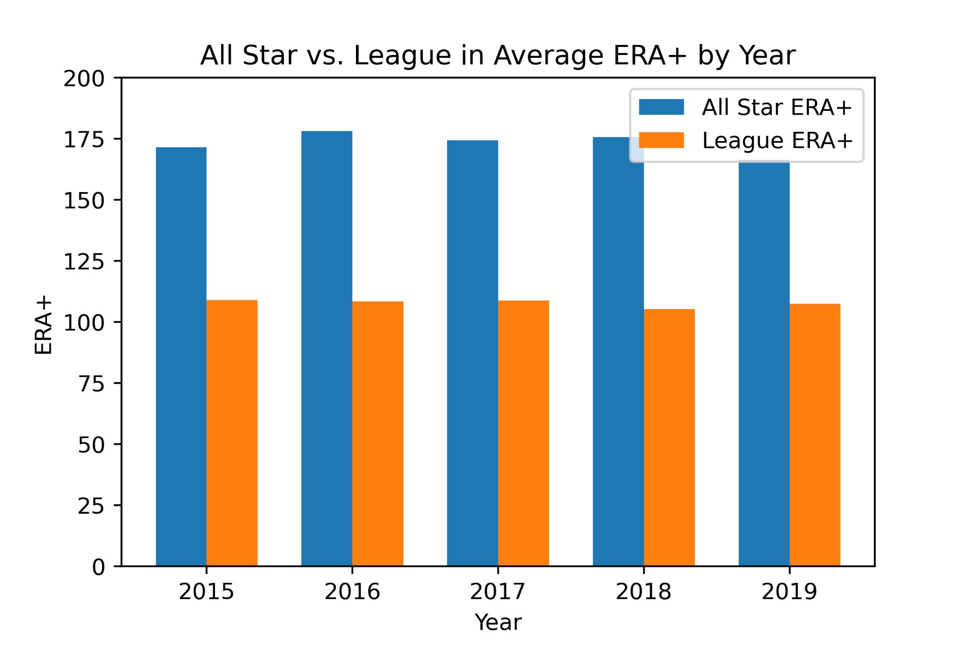
Notes:
Explain why ERA+ is the best benchmark

Slide 29
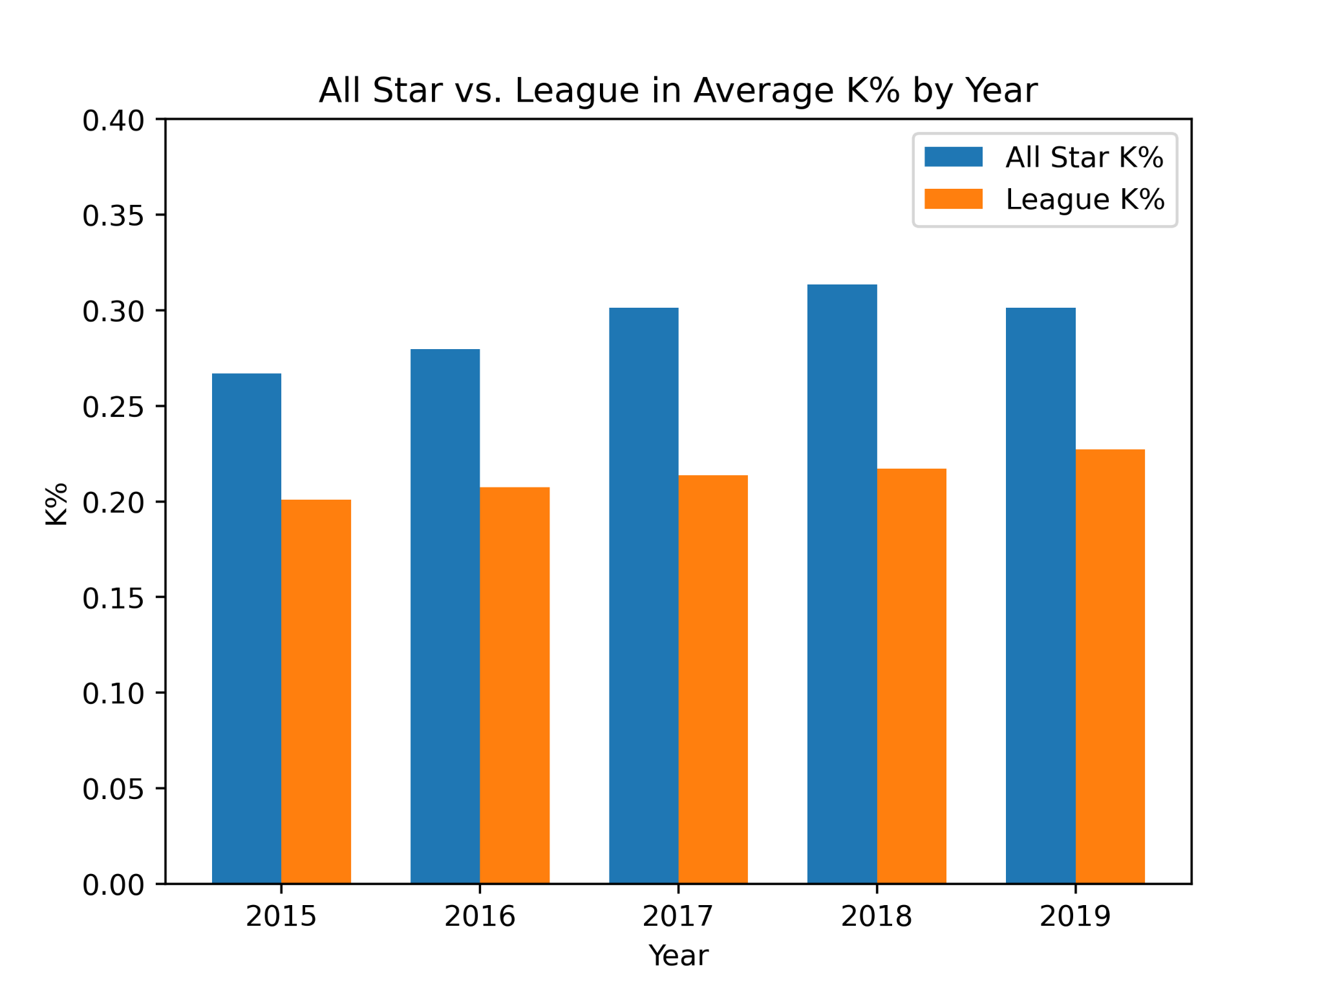
Notes:
Give short baseball background - you can either walk or strikeout someone if the ball is not put into play.

Slide 30
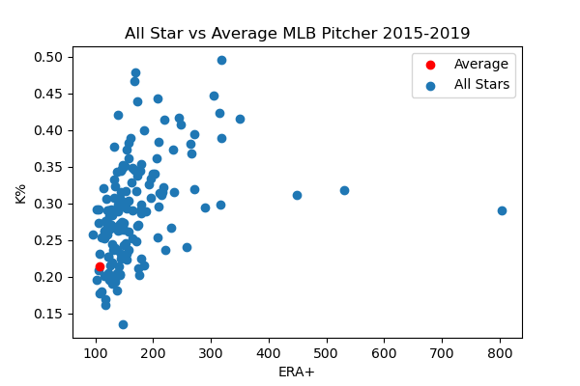
Notes:
Explain that ERA plus is a scale to determine how pitching effectiveness, typically around 100 is average. As you can see here, ERA plus is generally correlated with K%.
This is a follow up to the bar graph on the previous page.

Slide 31
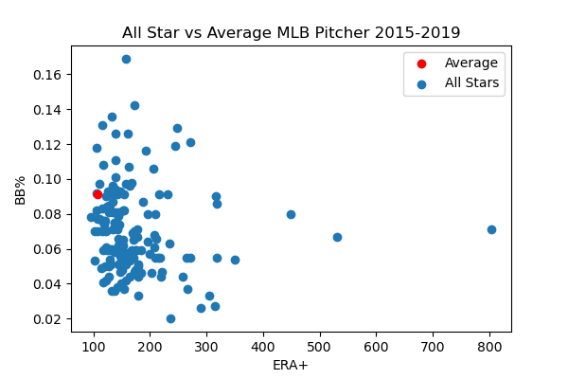
Notes:
Walks vs ERA+ - interestingly not as correlated.

Slide 32
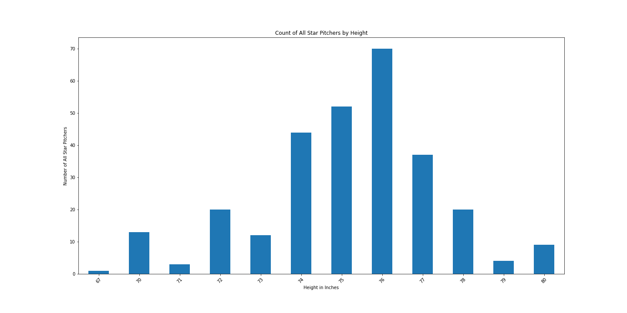
Notes:
6’2 (74 inches) seems to be a jumping off point for a threshold of all star pitchers.
Notice how 72 inches is significantly higher than 73 and 71.

Slide 33
Conclusion
Is there predictive value from these insights?

Slide 34



Many thanks!!

Slide 35
Backup Slides

Slide 36











All Stars by Flag
This is more detailed, but harder to visualize, lets keep going

Slide 37
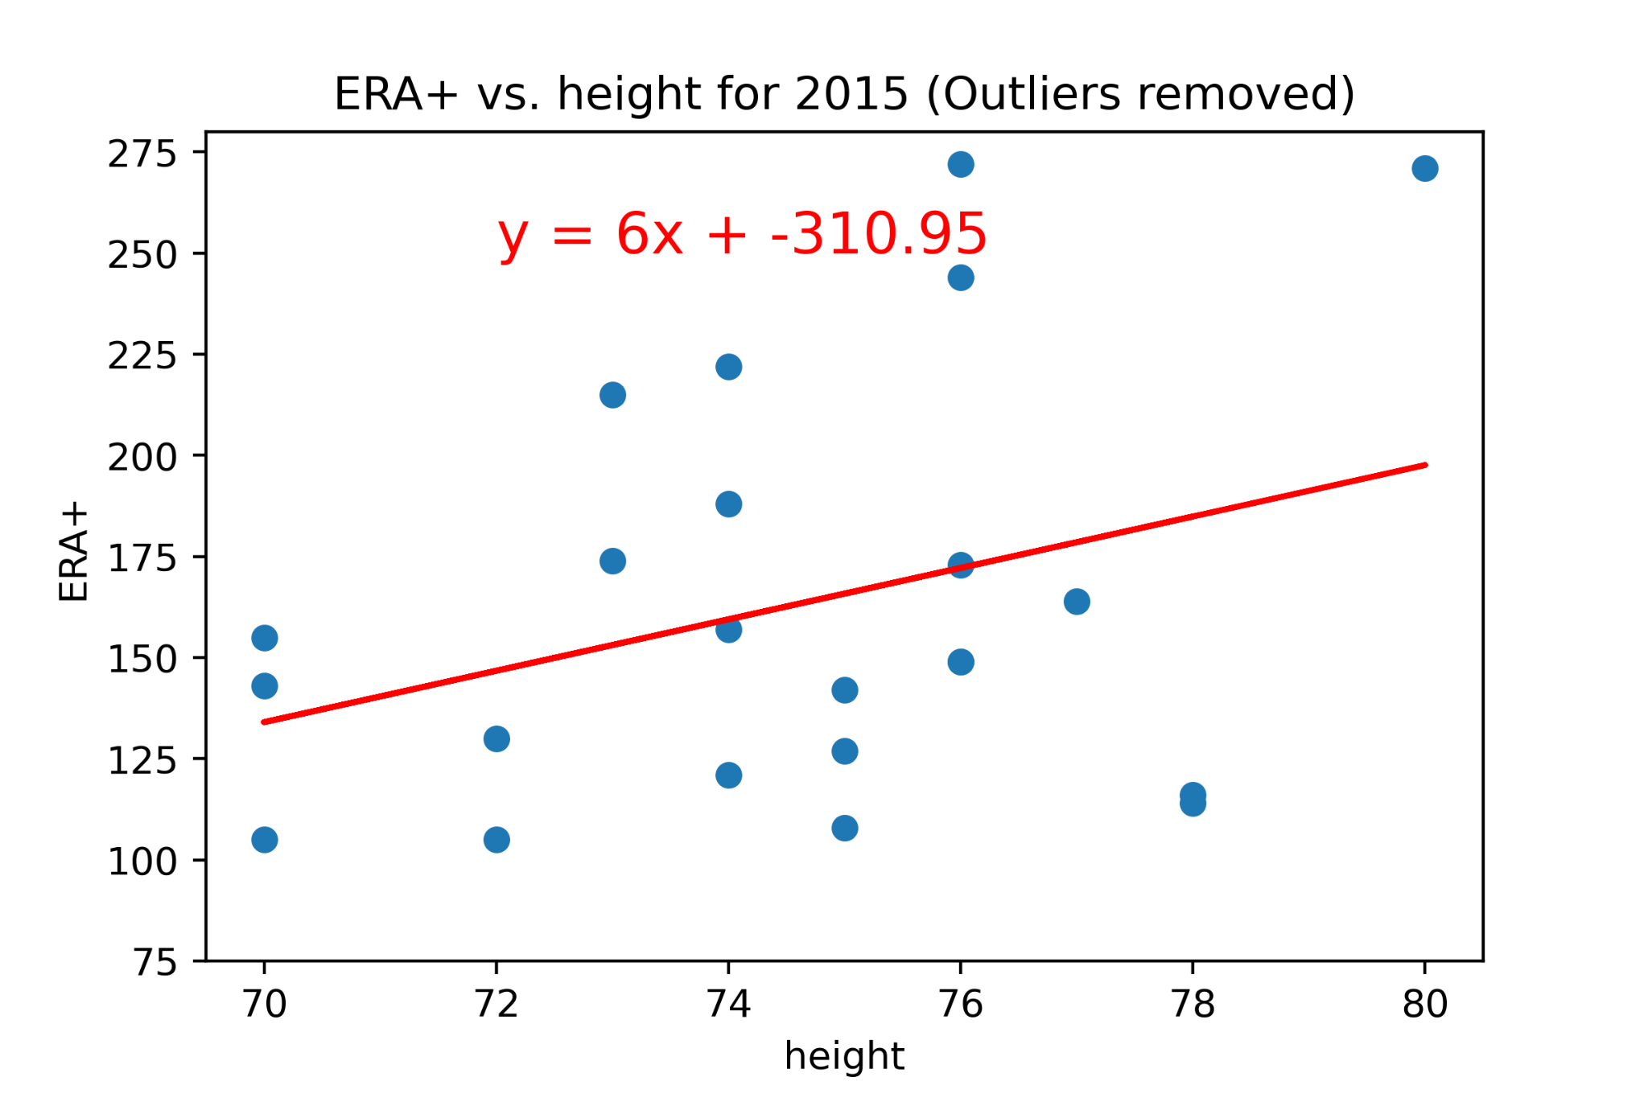
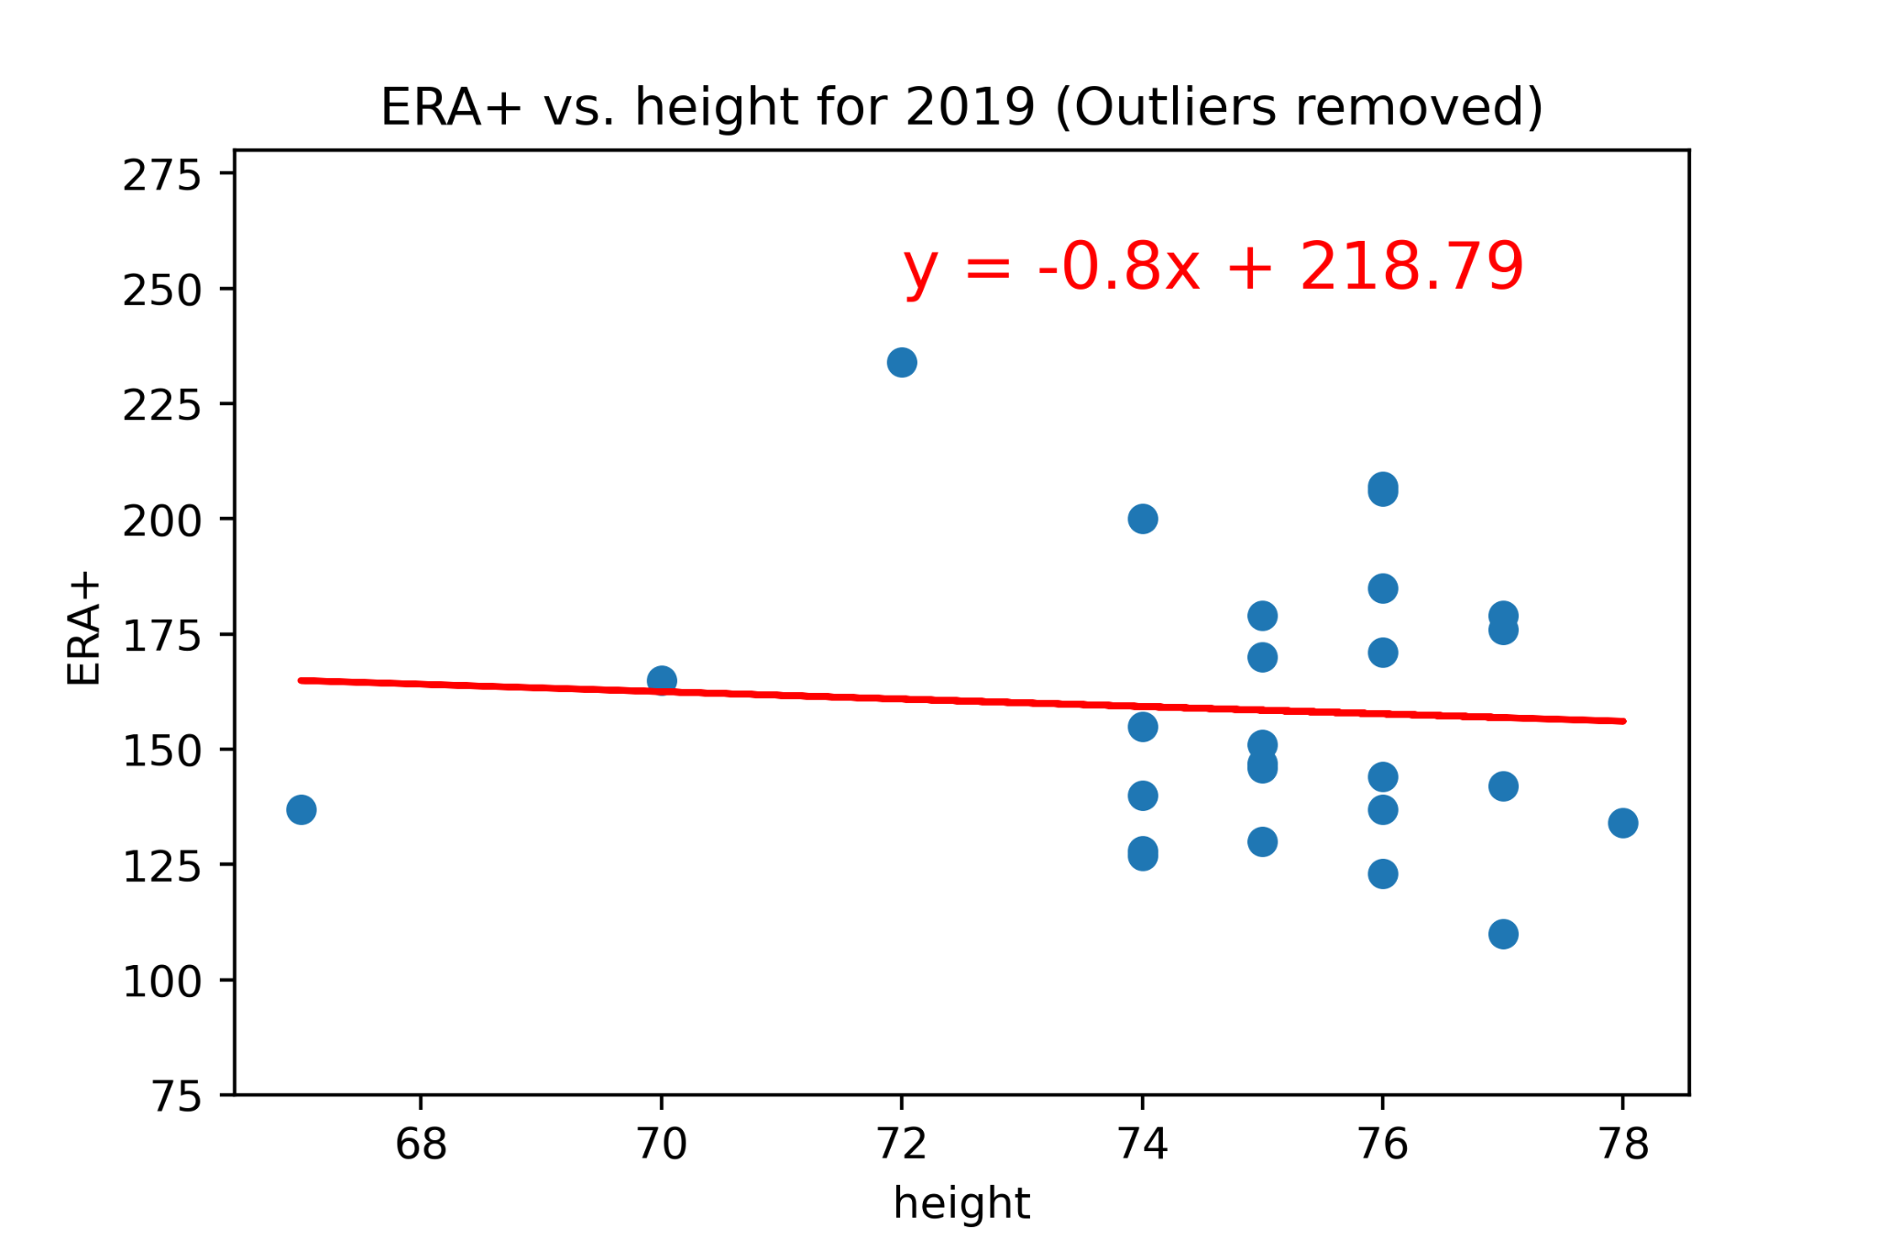
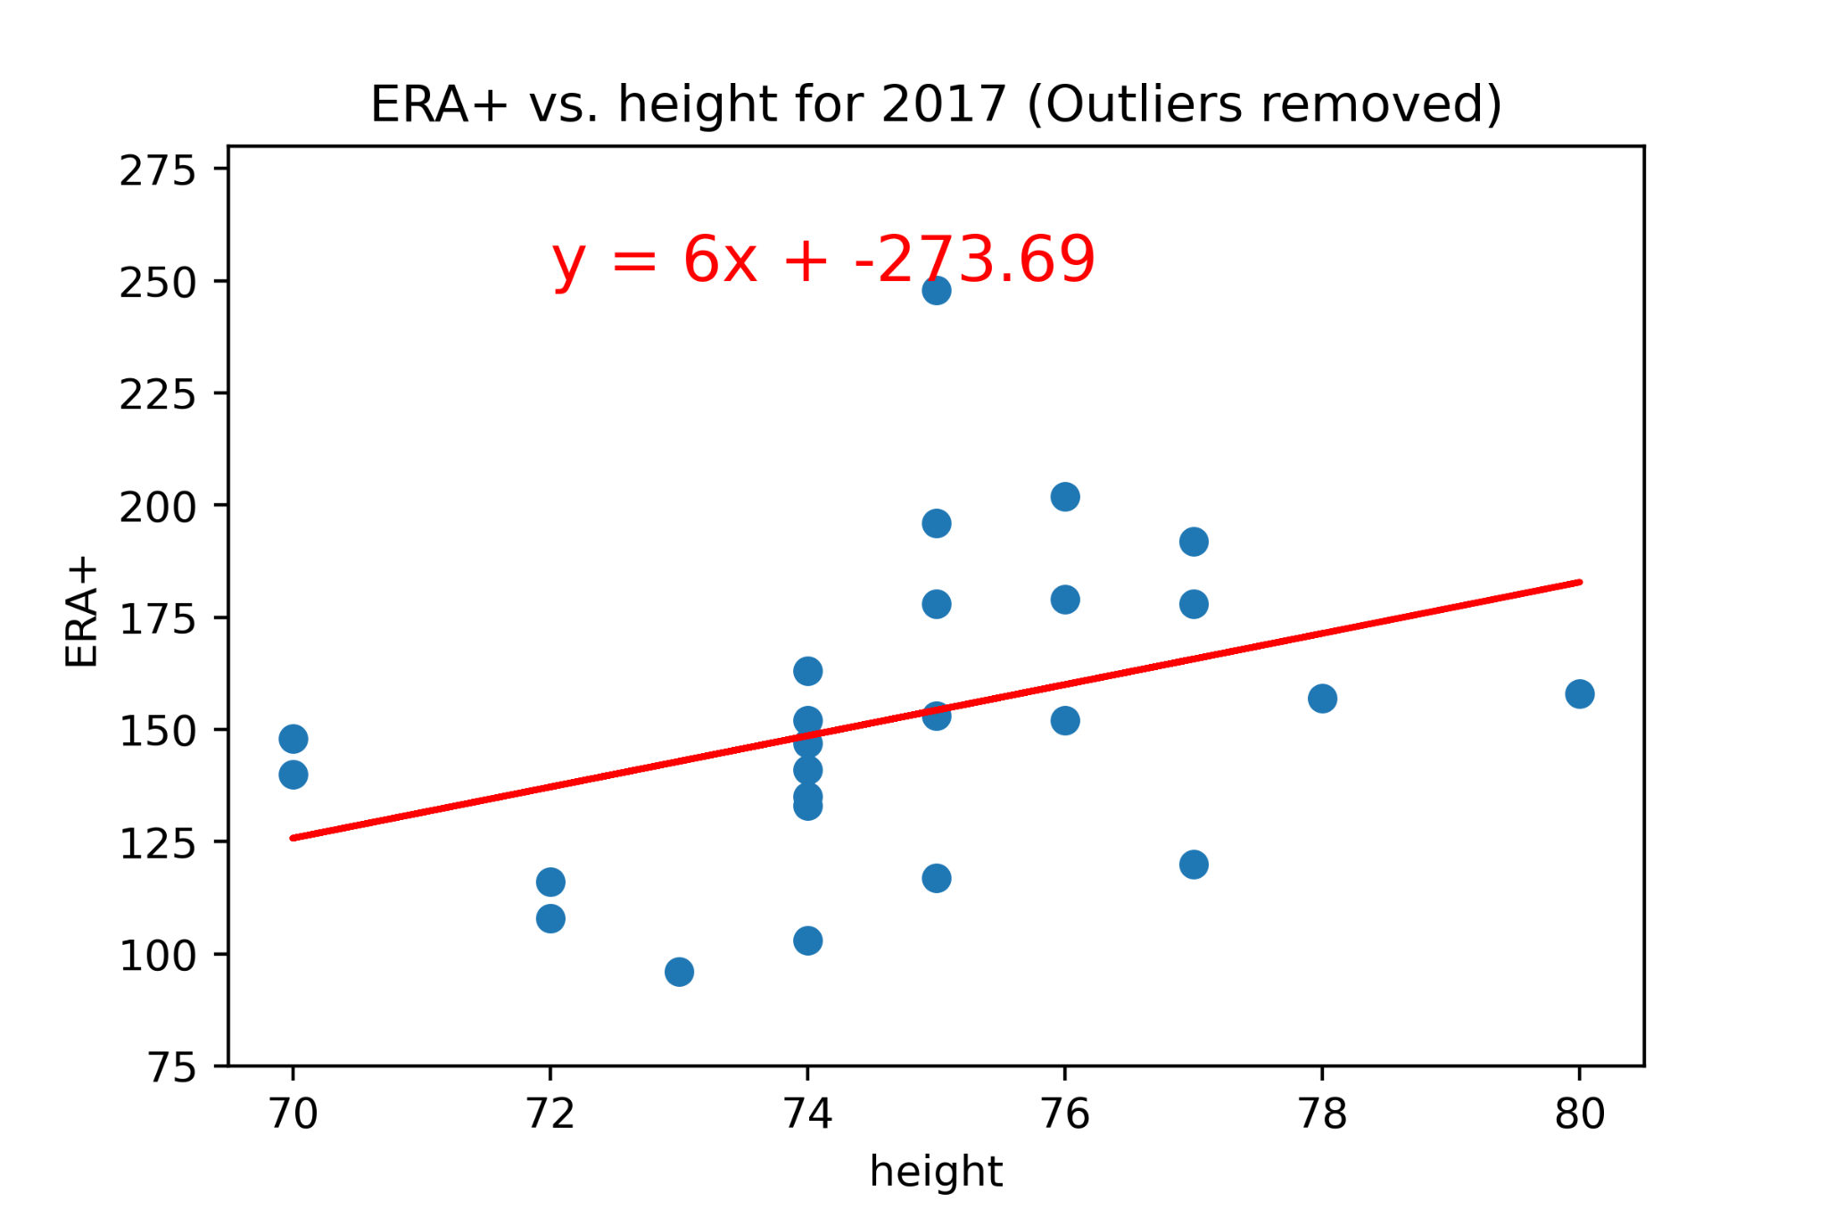
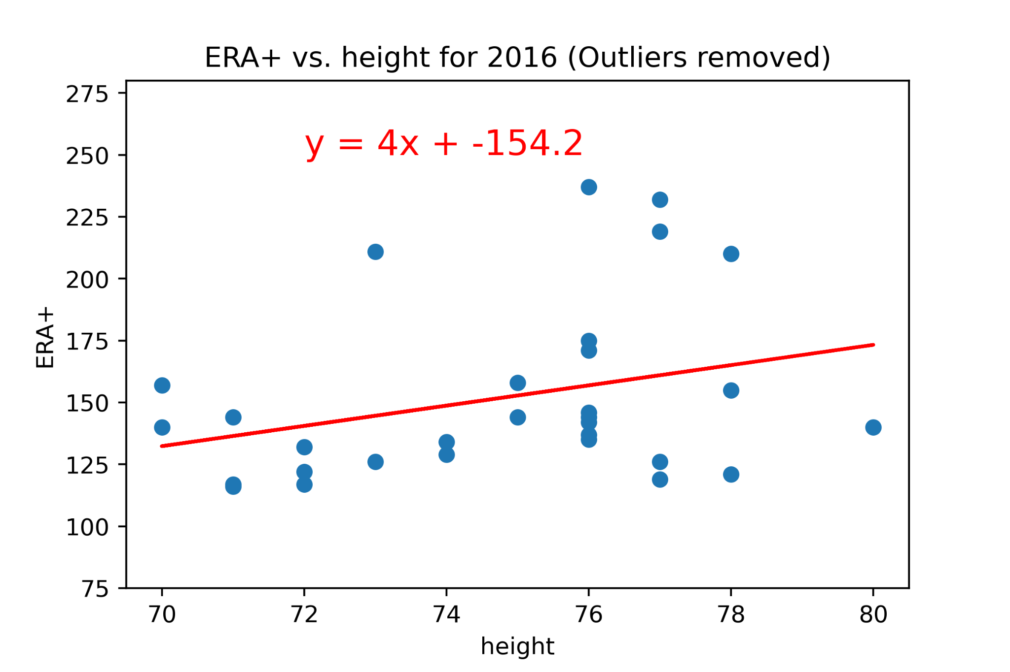
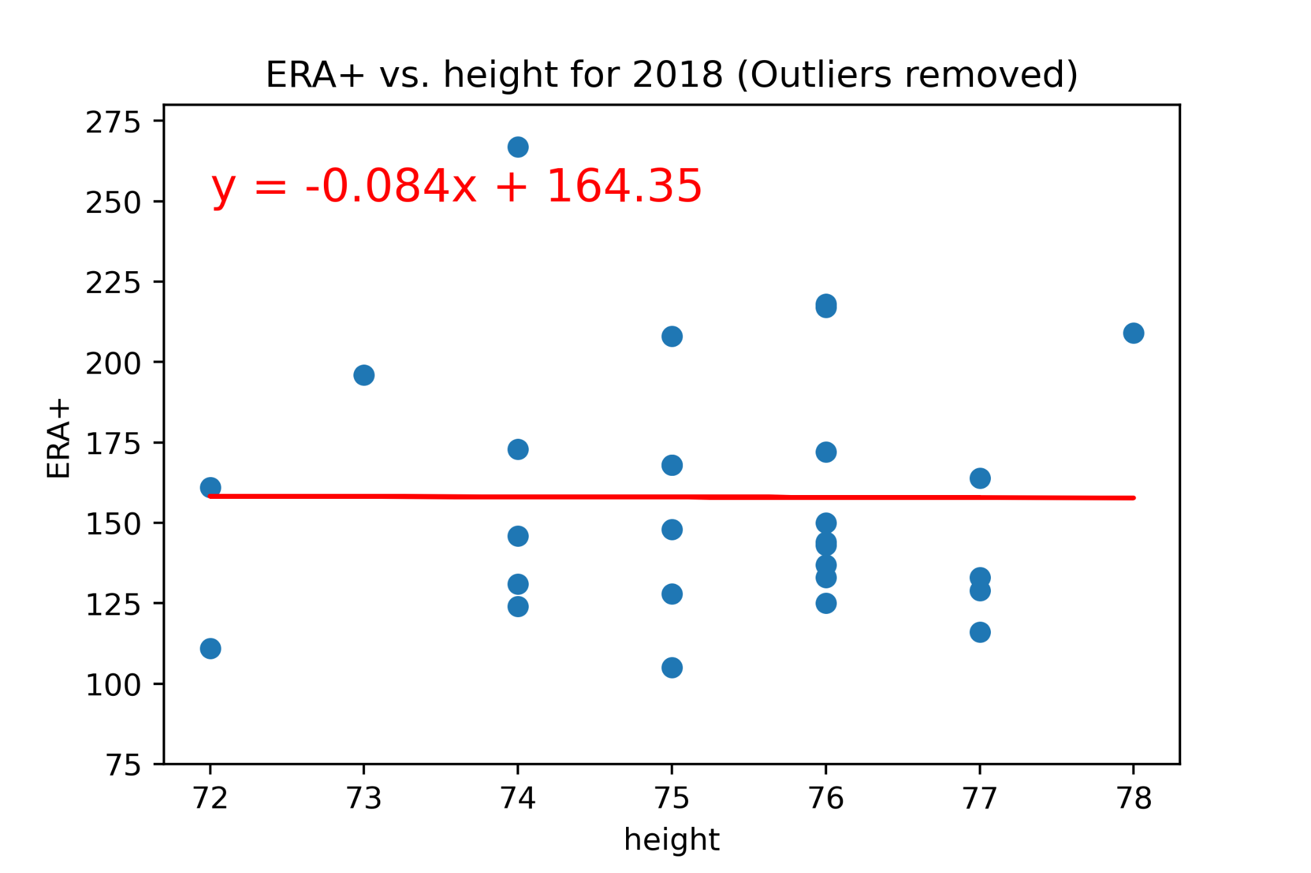
ERA+ Without Outliers
Conclusion: Pitcher ERA+ was positively correlated for years 2015-2017, but appears to show no correlation in 2018/2019

Slide 38
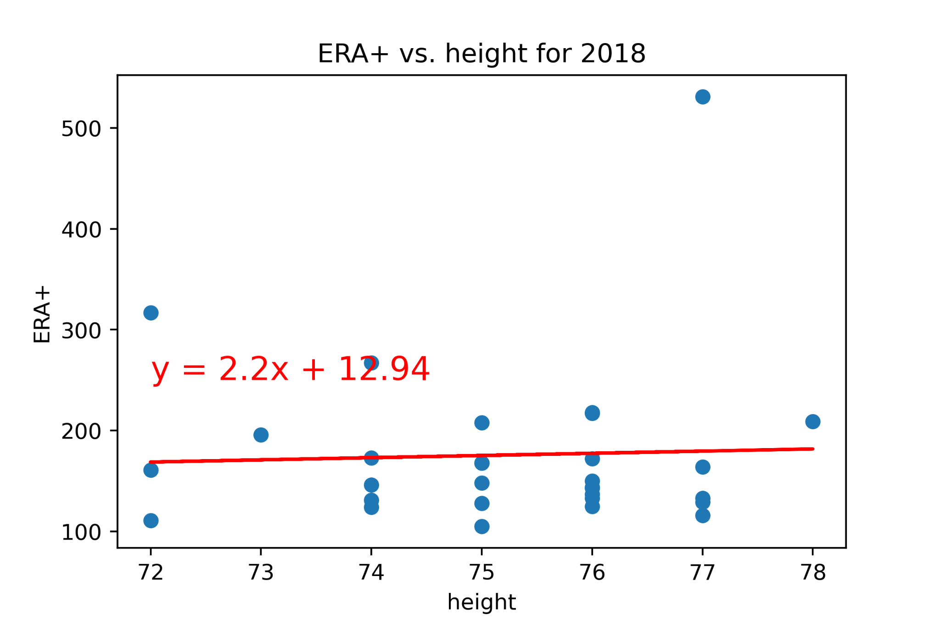
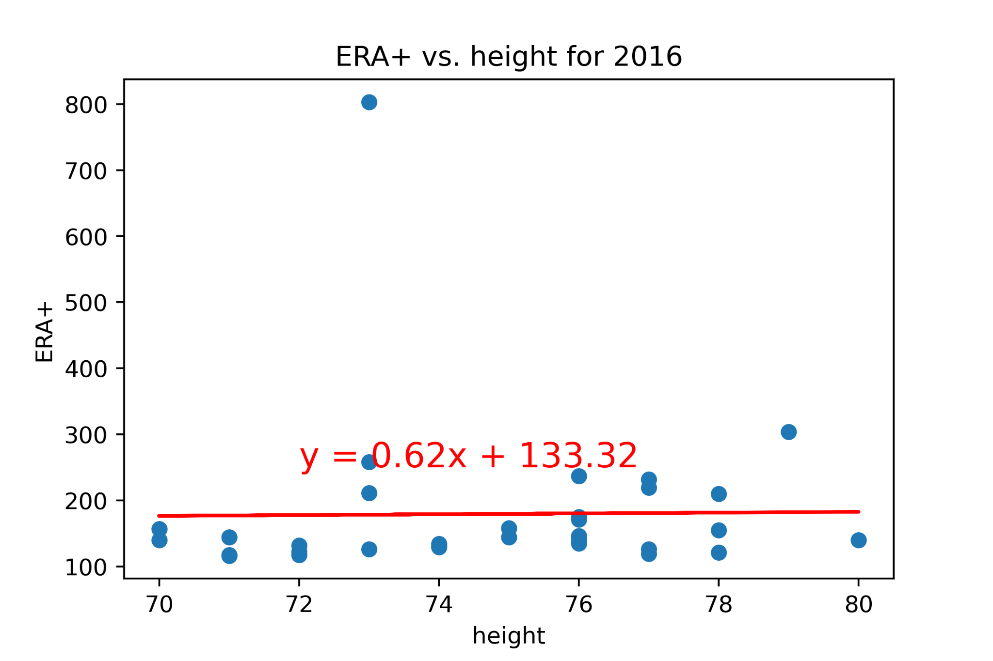
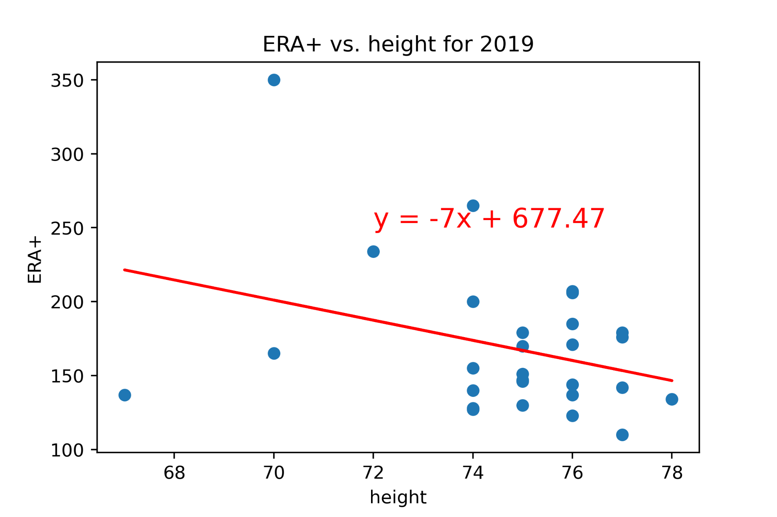
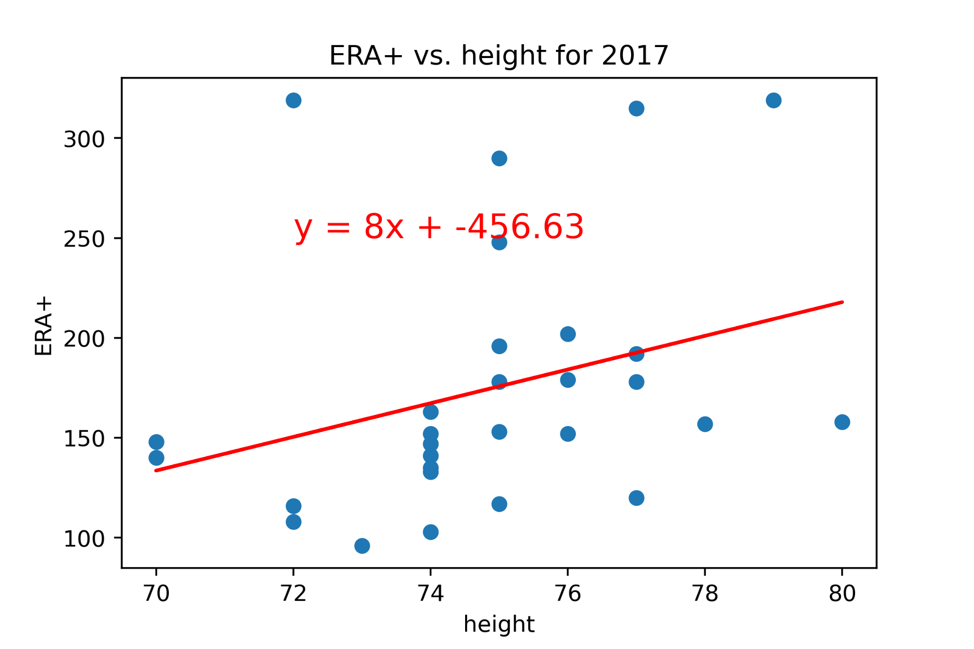
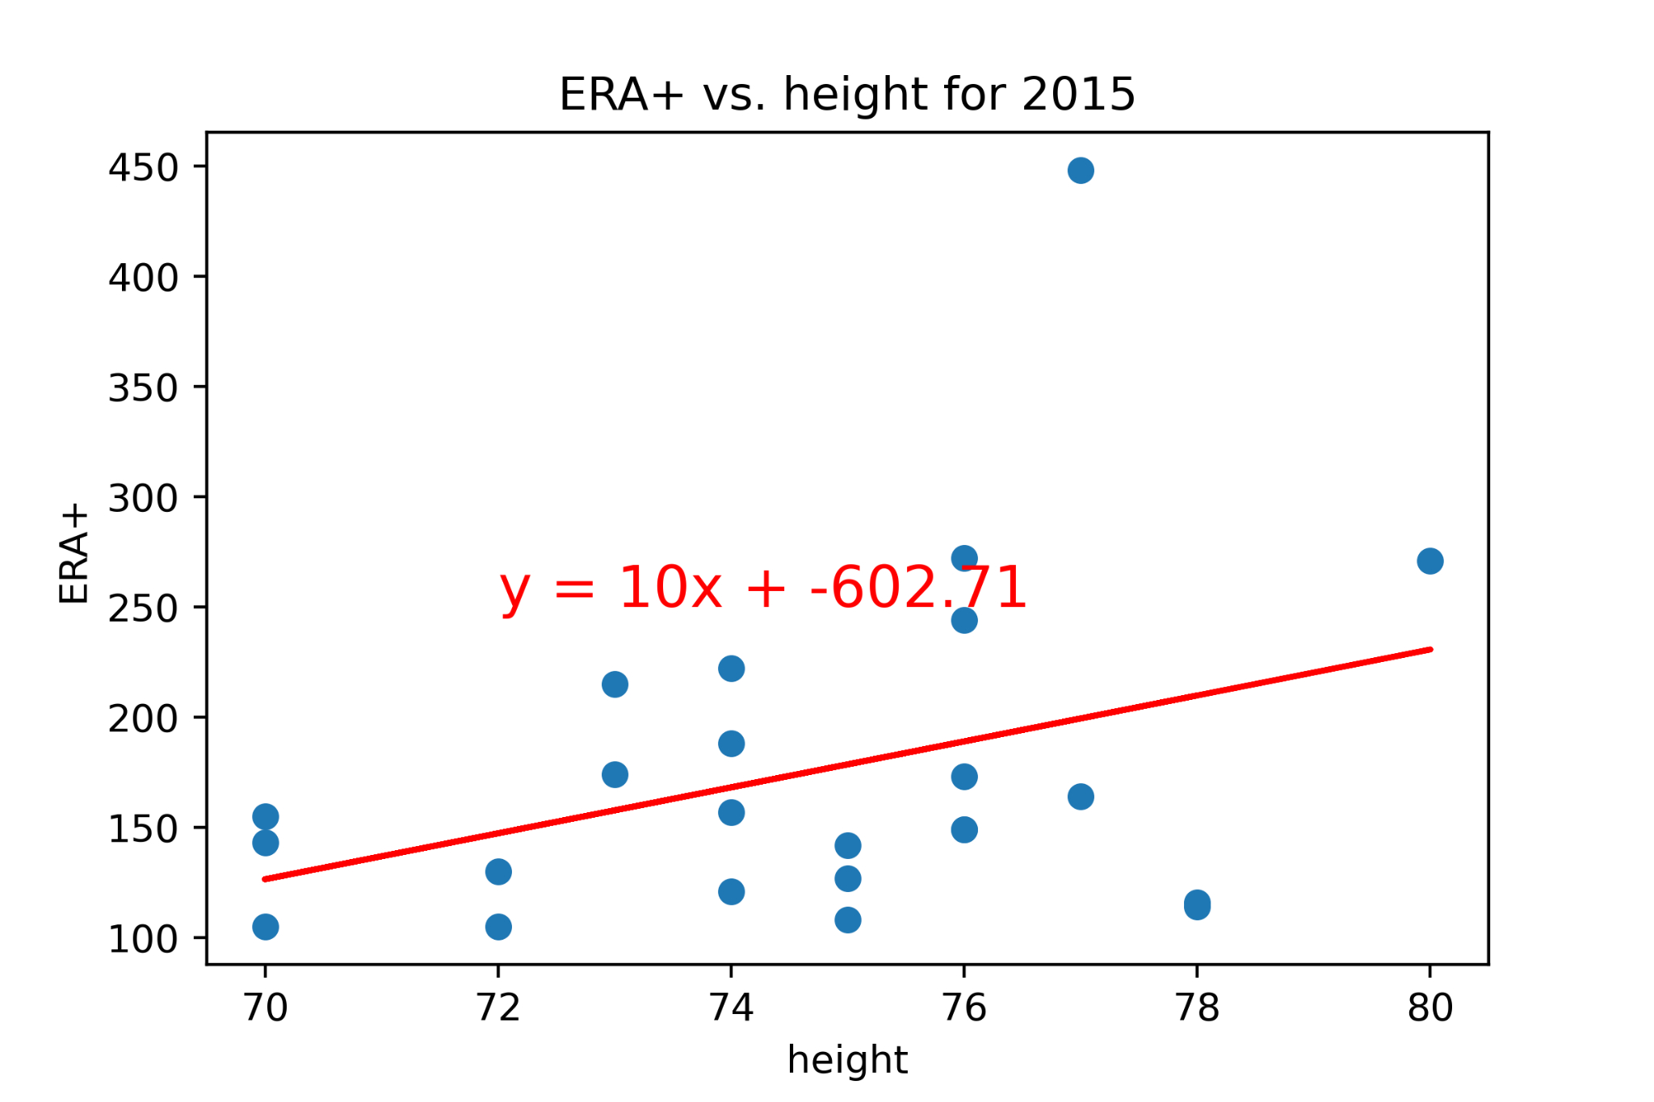
Does Height Predict ERA+?
ERA+ is an indicator of the runs a pitcher allows (the higher the score, the better the pitcher)
Conclusion: Height is not a good predictor of ERA+
But...wait!!

Slide 39
Does Height Predict ERA+?
Notes:
ERA+ is an indicator of the runs a pitcher allows (the higher the score, the better the pitcher)
Conclusion: Height is not a good predictor of ERA+
But...wait!!

Slide 40
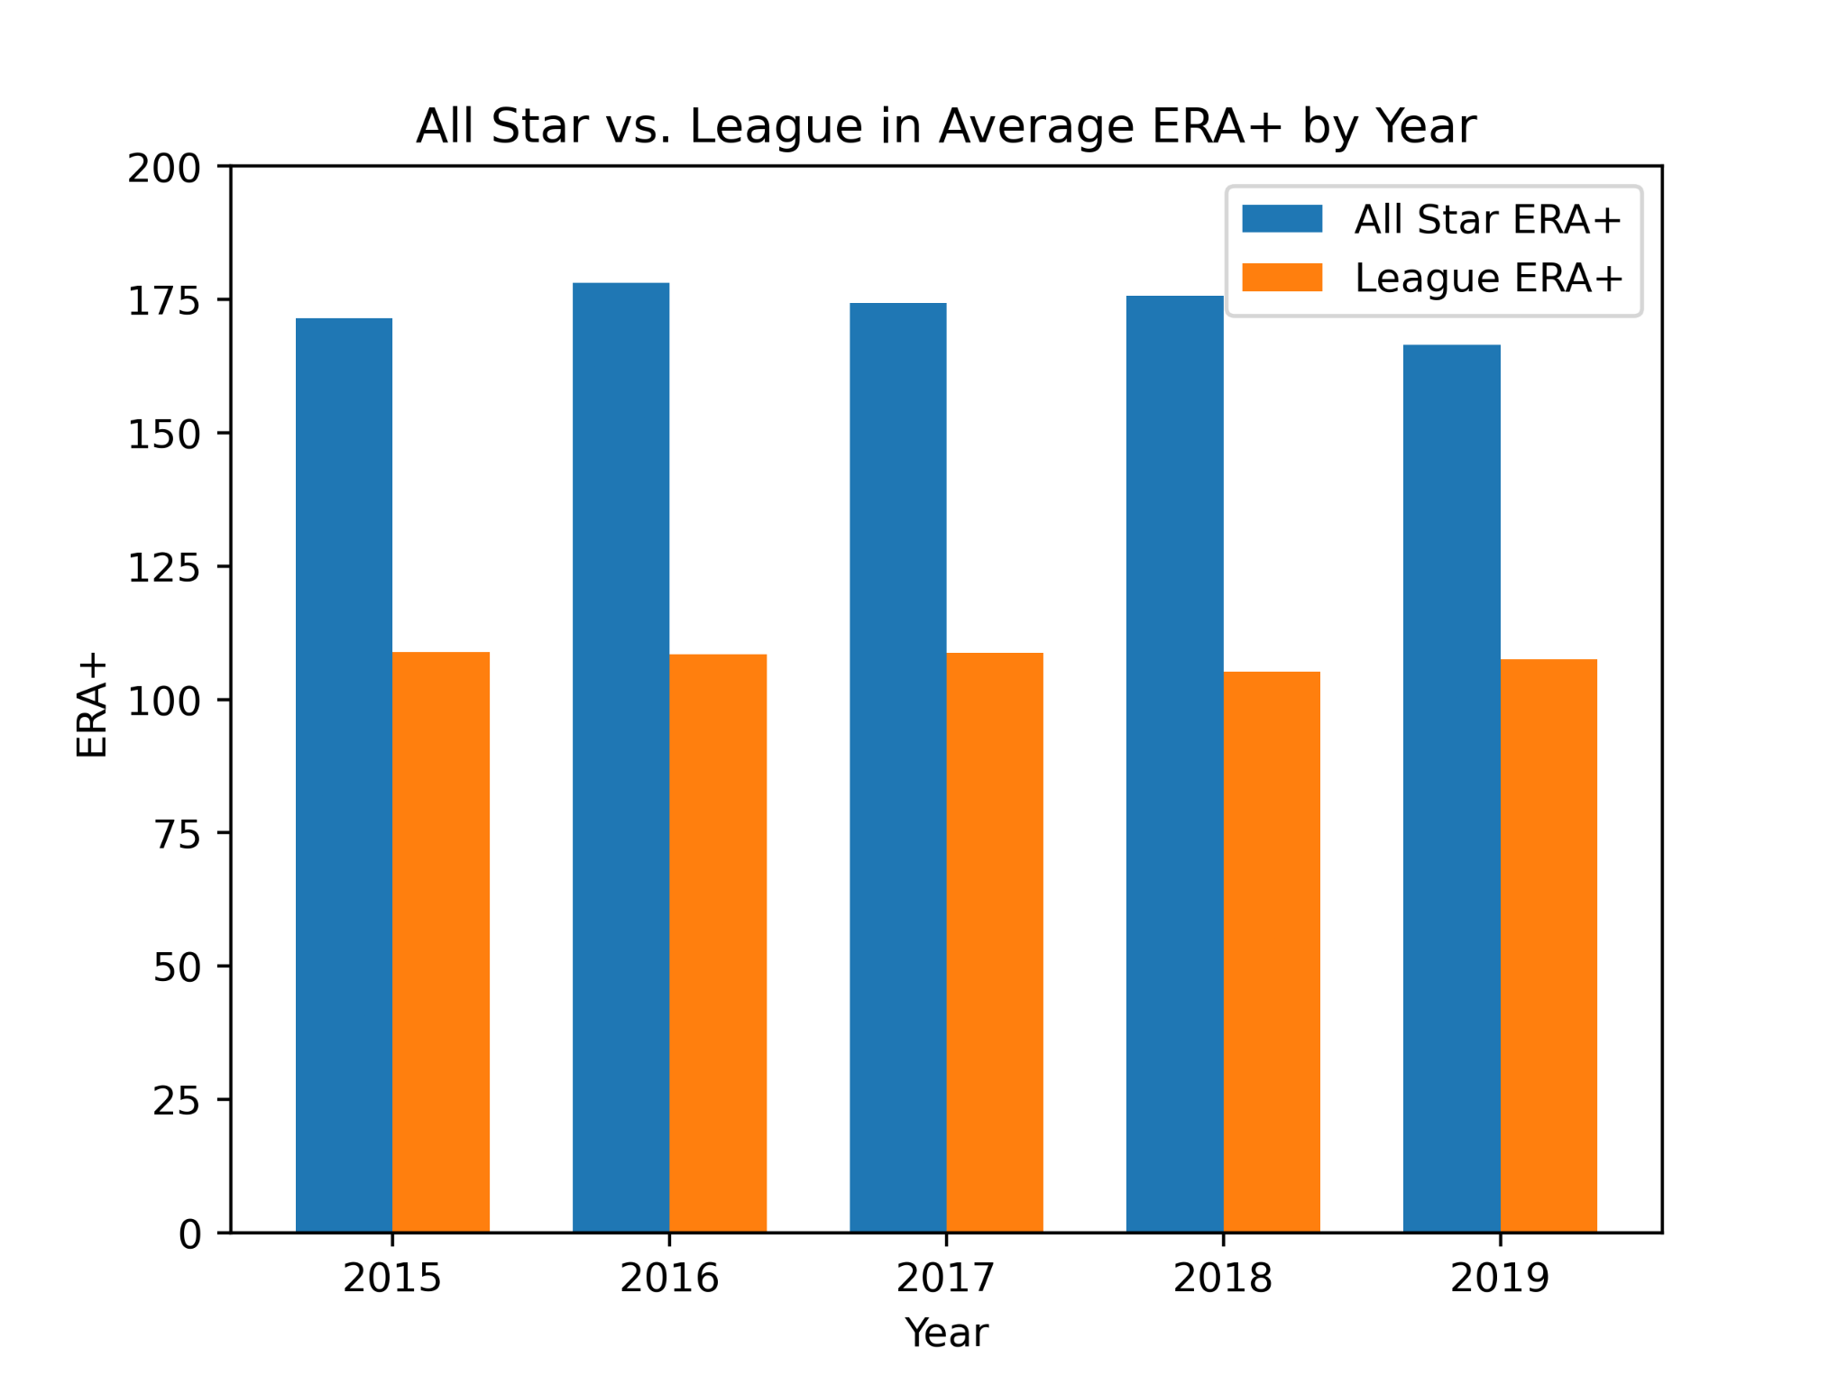
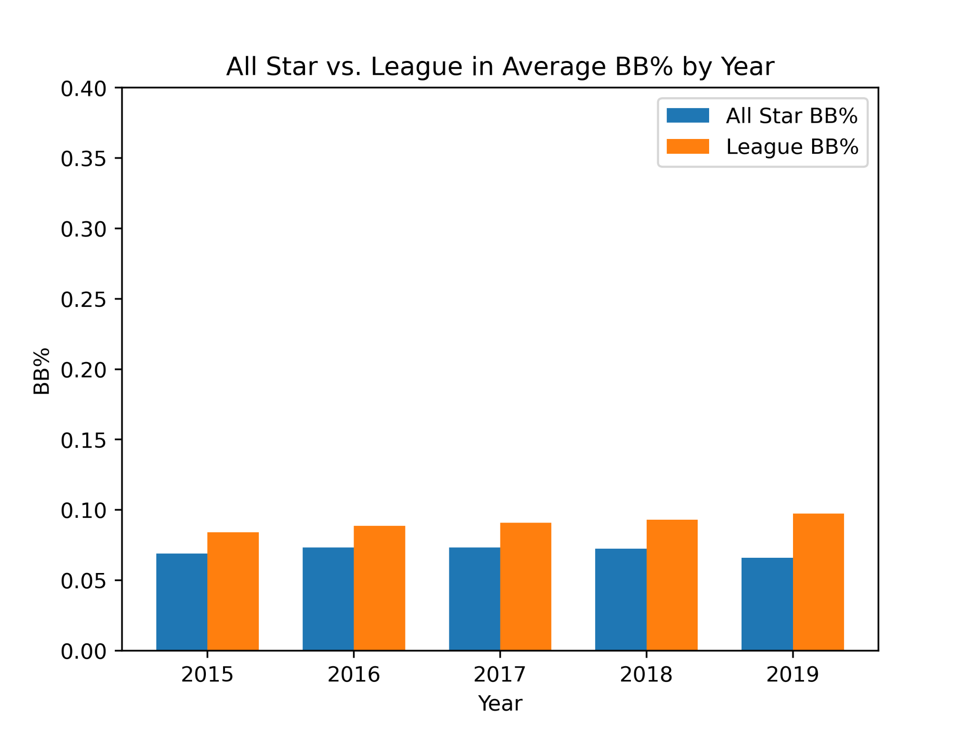

All-Stars vs. League
How much better are the All Star pitchers over the League?

Slide 41
ERA+ Without Outliers
Conclusion: Pitcher ERA+ was positively correlated for years 2015-2017, but appears to show no correlation in 2018/2019

